Slide 1
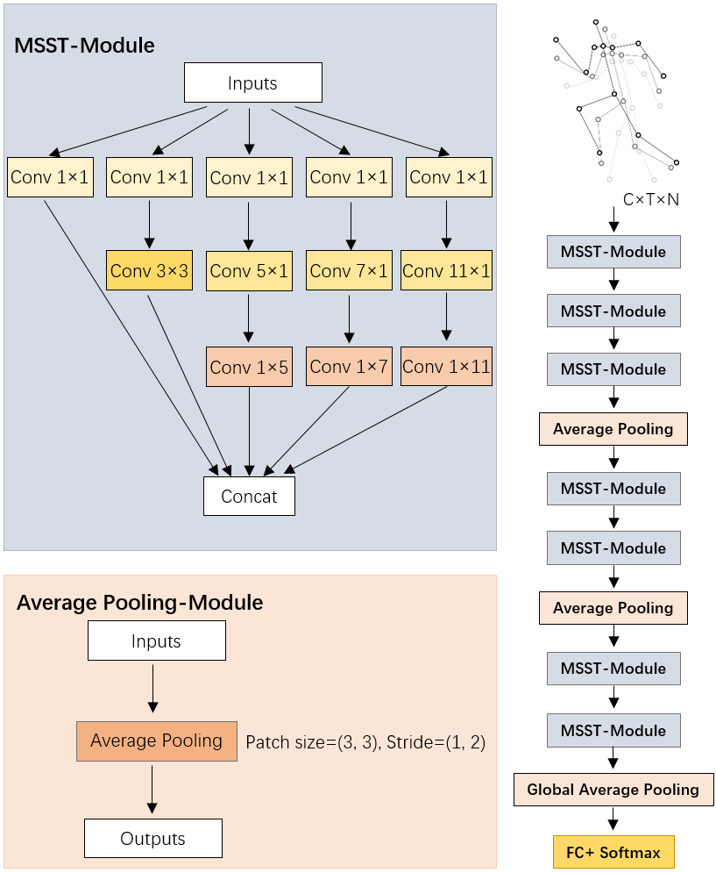
Skeleton-based Action Recognition with Multi-scale Spatial-temporal Convolutional Neural Network
Qin Cheng, Ziliang Ren, Jun Cheng, Qieshi Zhang, Hao Yan and Jianming Liu
Guilin University of Electronic Technology, Guilin, China
Action recognition based on skeleton data needs comprehensive spatial-temporal features.
A novel MSST-Module is established to capture robust spatial-temporal features.
The MSST-Net constructed by MSST-Module achieved remarkable performance on two large dataset.
Structure of MSST-Net

