Slide 1
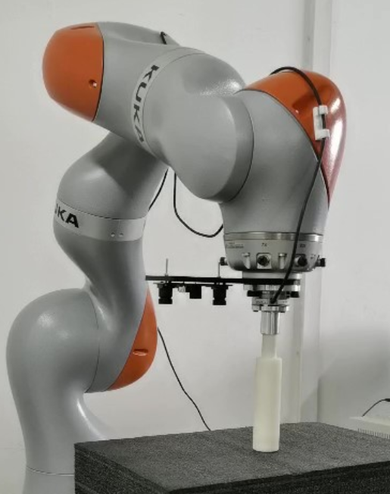
Zener Model based Impedance Control
for High-precision Force Tracking
of Robot-environment Interaction
Xi Wu, Panfeng Huang, Zhengxiong Liu and Zhiqiang Ma
School of Astronautics, Northwestern Polytechnical University, China
Combined the conventional Voigt impedance model and Maxwell impedance model.
Switching model with parameter changing.
Force tracking is less affected by the uncertainty of the robot dynamics and environmental force.
Proving the system is still stable even in the presence of uncertainties in the environment.

