Slide 1
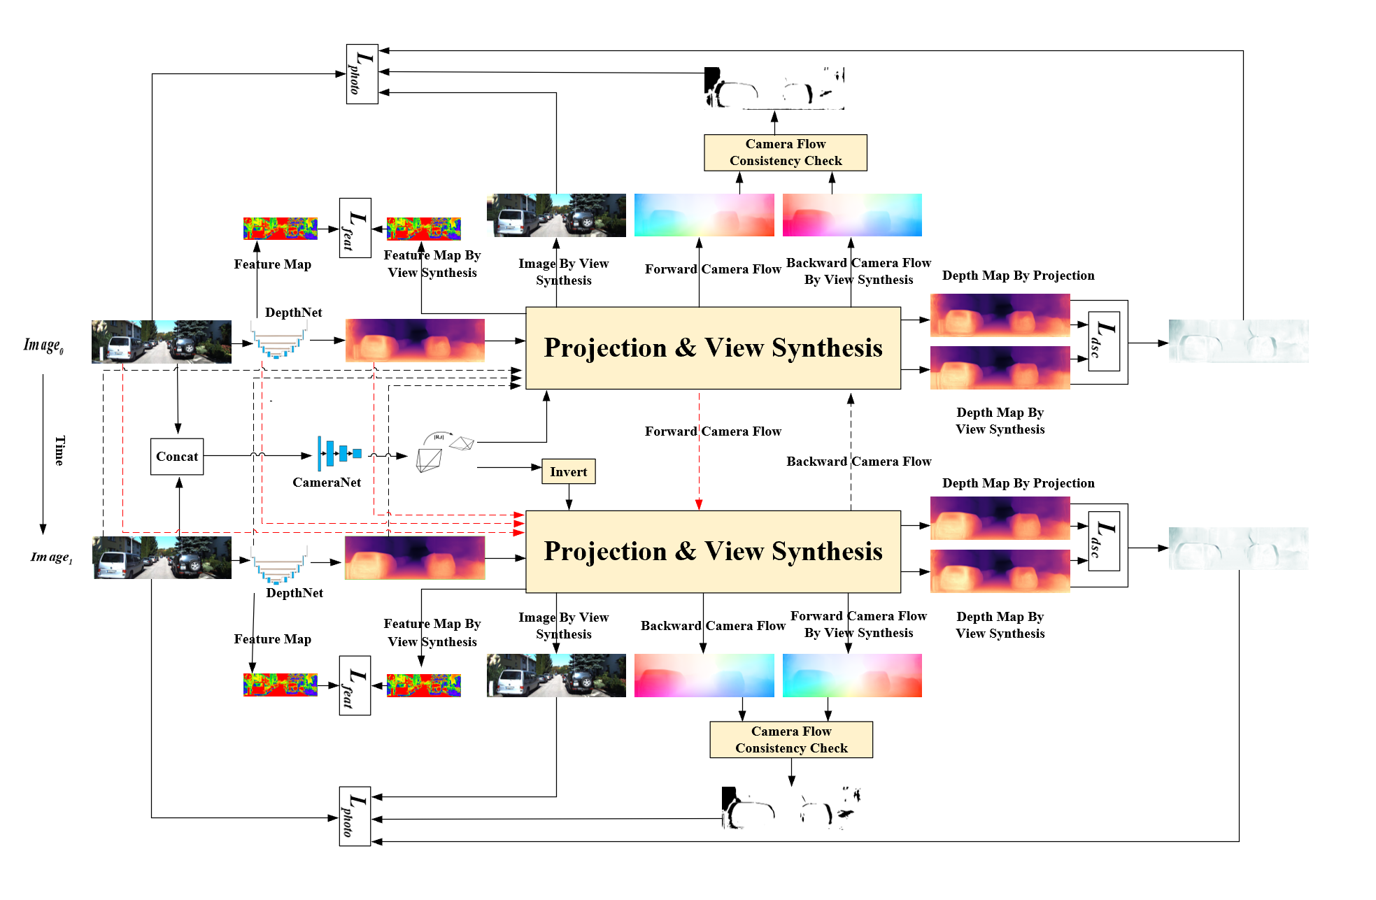
Bidirectional Weighted Loss with Feature Perception for Self-supervised Learning of Consistent Depth-pose
Fei Wang, Jun Cheng and Penglei Liu
CAS Key laboratory of Human-machine Intelligence-Synergy Systems, Shenzhen Institute of Advanced Technology, Chinese Academy of Sciences, China
Take full advantage of limited data by using the bidirectional photometric loss.
Deal with moving objects and occlusions by reweighting the bidirectional photometric loss.
Improve the robustness for textureless regions by employing the bidirectional feature perception loss.
Enforce consistency between depths by employing the bidirectional depth structure consistency loss.
Diagram of the general framework

