Slide 1
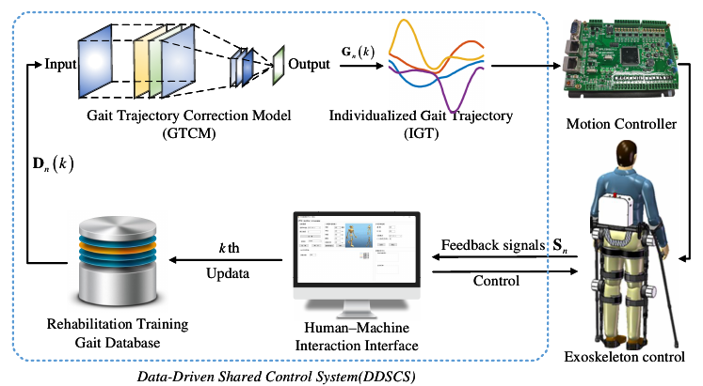
A data-driven shared control system for exoskeleton rehabilitation robot
Feng Li, Yong He*, Jinke Li, Jiangpeng Ni and Xinyu Wu
Guangdong Provincial Key Lab of Robotics and Intelligent System, Shenzhen Institute of Advanced Technology, Chinese Academy of Sciences, Shenzhen 518055, China.
A novel shared control system is designed, which solve the problem of exoskeleton robot system integration.
A gait trajectory revision mode based on data iteration is designed.
The modular development of human-machine interaction interface is realized to make the exoskeleton rehabilitation robot system more humanized and visual.
Data-driven shared control system control framework

