Slide 1
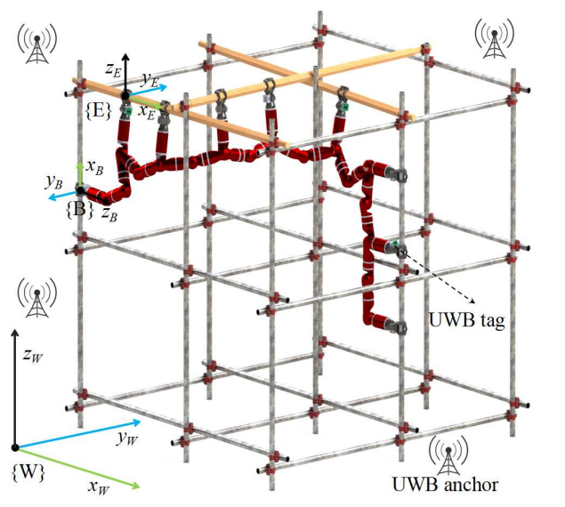
Localization of Biped Pole-climbing Robots in Spatial Trusses
Jingheng Chen, Shaobin Zhuang, Shichao Gu, Yisheng Guan
and Haifei Zhu*
School of Electromechanical Engineering, Guangdong University of Technology, China
A two-stage localization method based on ultra-wideband (UWB) sensors is proposed.
The proposed method can locate the robot with a position error less than 100mm and an orientation error less than 5°.
The proposed method can be applied to global localization of biped pole-climbing robots moving in spatial trusses.

