Slide 1
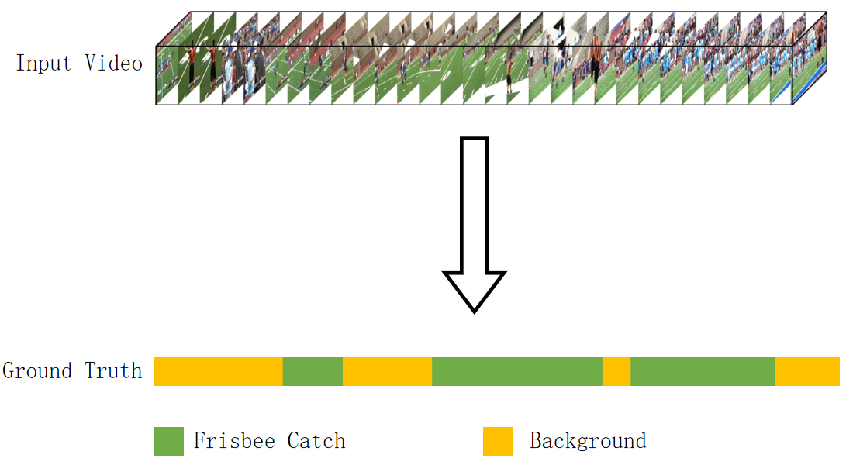
Two Stream Dynamic Threshold Network for Weakly-Supervised Temporal Action Localization
Hao Yan, Jun Cheng, Qieshi Zhang, Ziliang Ren, Shijie Sun,Qin Cheng
Shenzhen Institute of Advanced Technology, Chinese Academy of Sciences, China
Weakly-supervised methods only require video-level labels to train the models.
The proposed DH-WTAL features a dynamic attention threshold decision for the attention.
Our model further adjust the extreme
values of the attention mechanism for different videos accordingly.

