Slide 1
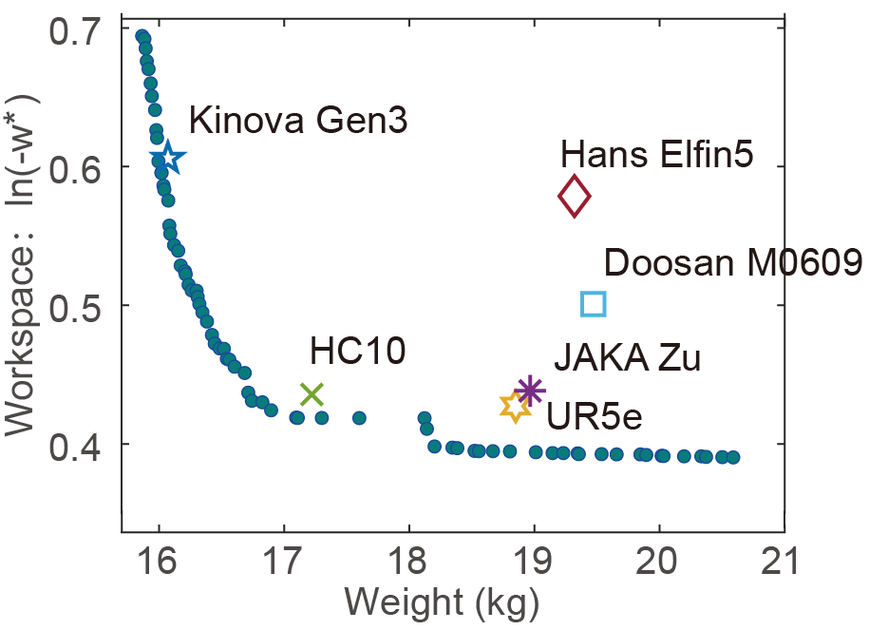
Optimization Design of Configuration, Structure and Drive Train Synthesis for Serial Robotic Arms
Jingchen Li^{1,2}, Jia Liu², Hongyu Ding¹,
Yisen Hu^{1,2} and Jianxin Pang¹
¹UBTECH Robotics Inc., China
²Shenzhen Institutes of Advanced Technology,
Chinese Academy of Sciences, China
New method for optimally integrated designing a robotic arm for desired functions and performances.
Complete and efficient co-simulation framework for optimization
A design example demonstrates the application of designing a light-weight arm with maximized workspace.
Optimization Pareto front and comparison with typical
collaborative robotic arms.

