Slide 1
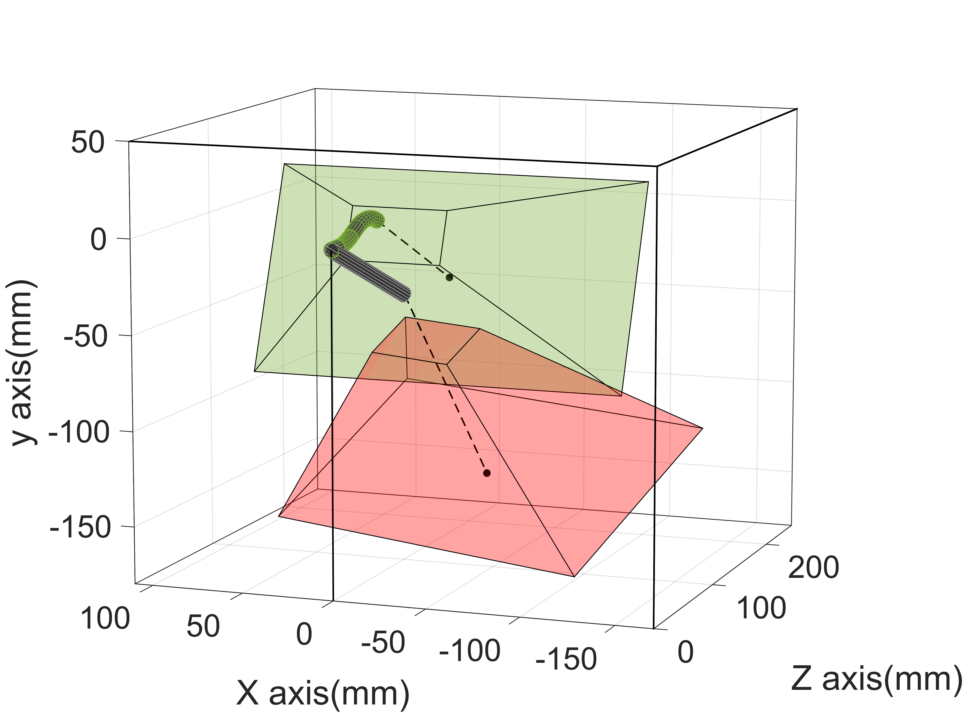
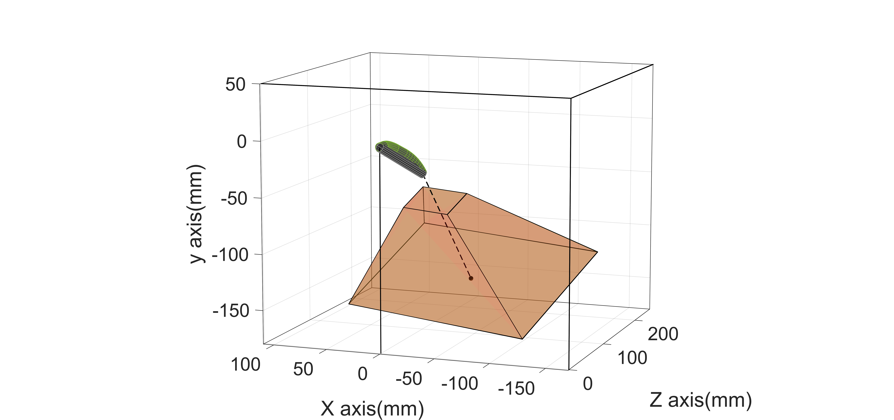
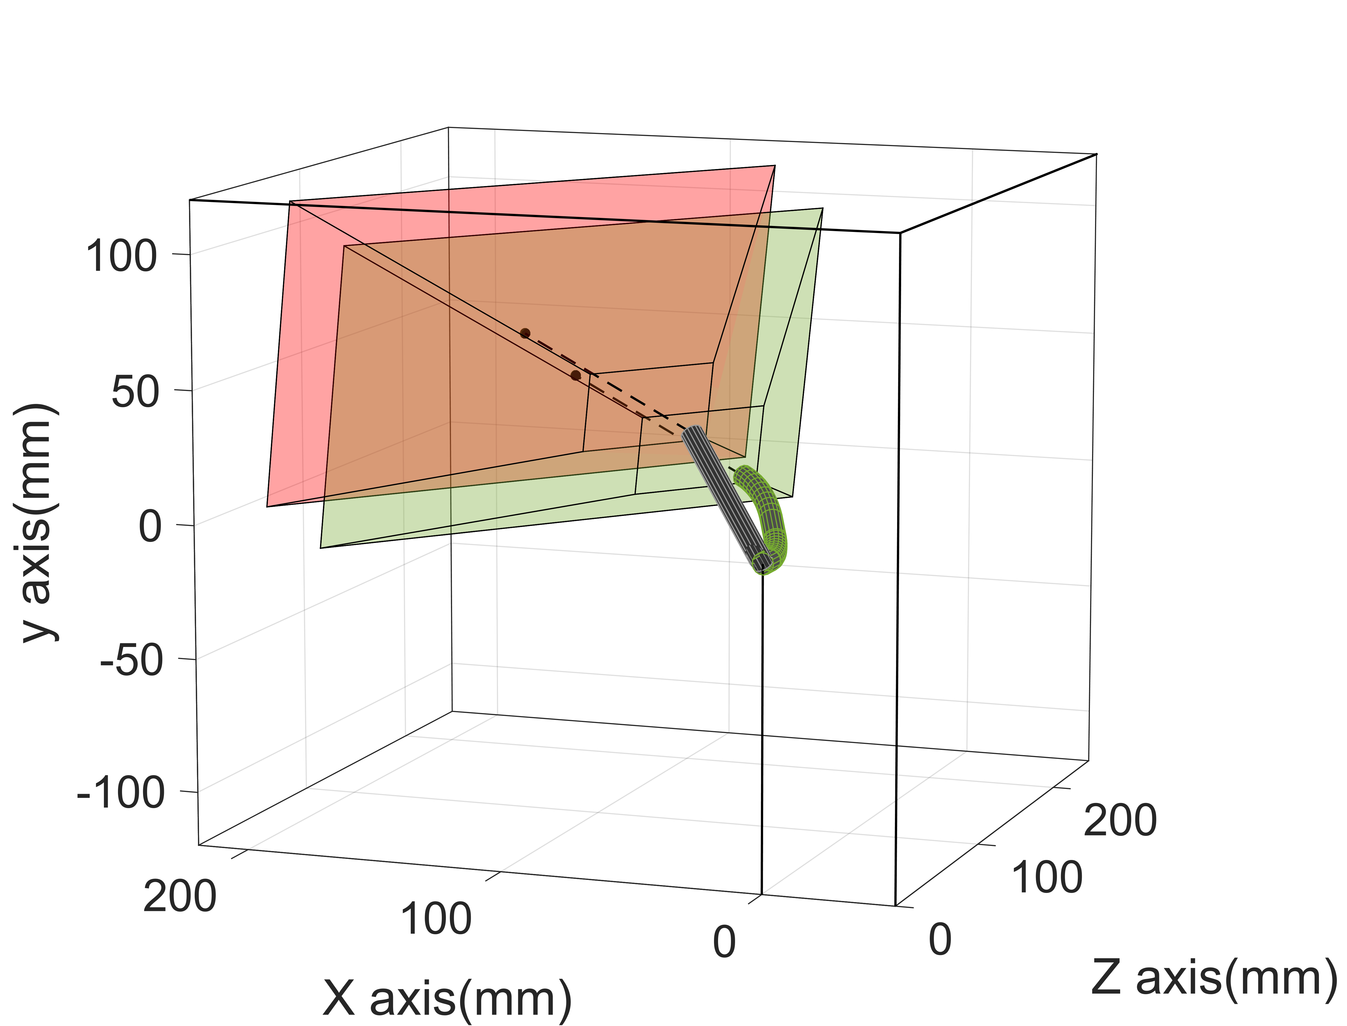
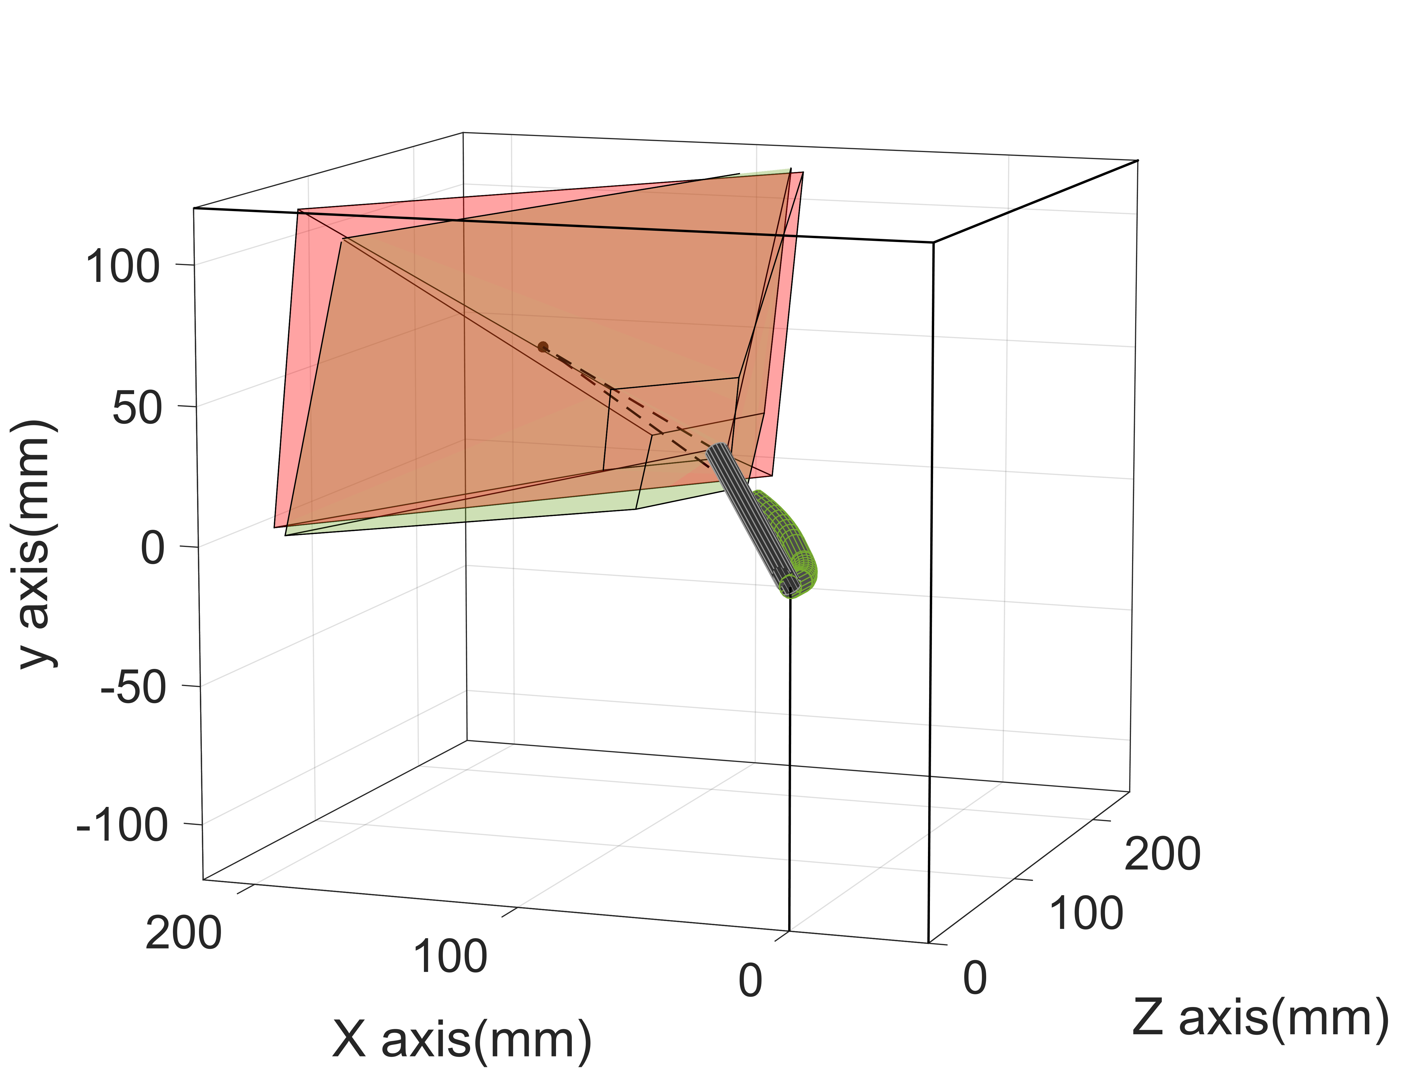
Inverse Kinematics Formulations of a Continuum Endoscope for a View Adjustment Similar to the
da Vinci Endoscope
Lifei Deng, Zhonghao Wu, Yifan Wang and Kai Xu
Shanghai Jiao Tong University, China
Linhui Wang
Department of Urology, Naval Medical University, China
Two inverse kinematics formulations are investigated on a 6-DoF continuum endoscope to achieve view adjustment similar to the da Vinci endoscope.
Dimension-reduced inverse kinematics formulation improves performances when resolved motion rate fails to converge.
a
Resolved motion rate
Dimension-reduced inverse kinematics
Incision point
The two vision pyramidal frustums coinciding
b
Resolved motion rate
Dimension-reduced inverse kinematics
Incision point
Dimension-reduced formulation has an 84.11% improvement compared with the resolved motion rate control.
Comparison results when the target visual point is (a) inside and (b) outside continuum endoscope’s workspace
Notes:
Digest must be prepared in MS Office PowerPoint and we accept no other format.
Use Arial 28pt font in bold face for the title.
Use Arial 24pt font for the authors and Arial 20pt font their brief affiliations.
Use 3 or 4 bullet points (limit each to less than 15 words in Arial Narrow 24pt font), and only 1 figure (replace the figure on the right with your figure).

