Slide 1
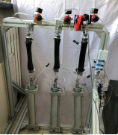
Experimental Study on Dynamic Characteristics and Fatigue of McKibben Pneumatic Artificial Muscles
Chen Wenlin, Ma Tianhua, Zhang Ying, Hao Lina*,
Wang Shuopeng, Liu Meng, Wang Rixin
Mechanical Engineering and Automation, Northeastern University,
Shenyang, China
Dynamic output characteristics of the PAMs.
Fatigue life test of the PAMs.
This paper focuses on the dynamic hysteresis behavior related to the load of PAMs.
Experimental platform of
fatigue life tests of PAMs.

