Slide 1
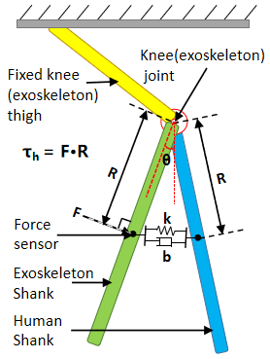
Adaptive Admittance Control of Human-Exoskeleton System Using RNN Optimization
Pengchen Lian, Yong He, Yue Ma, Jingshuai Liu and Xinyu Wu
Shenzhen Institute of Advanced Technology, Chinese Academy of Sciences, China
A new adaptive admittance control law is proposed, which provides a harmonious human-exoskeleton interaction.
The proposed admittance control law is further optimized by Jordan Recurrent Neural Network(JRNN).
Compared with fixed admittance control, the proposed method significantly improves the interaction level.
Human-exoskeleton interaction model

