Slide 1
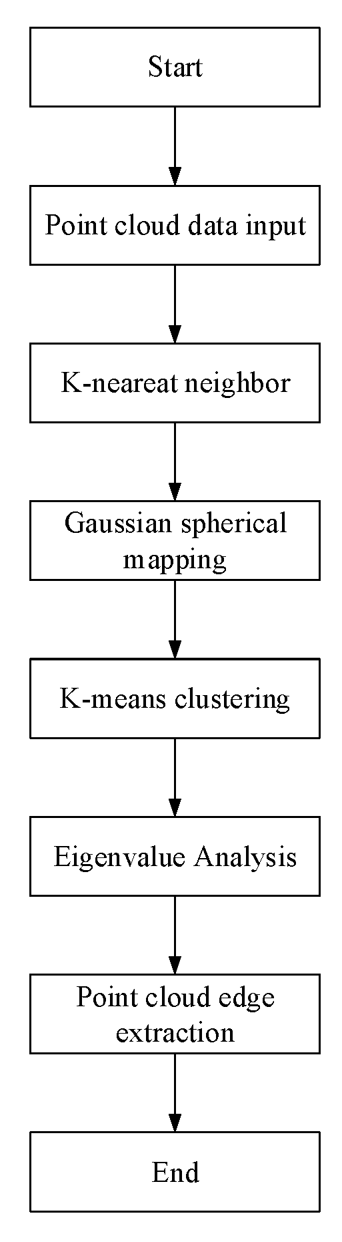
Fast and Accurate Edge Extraction Algorithm of Stacked Workpiece Point
Keping Liu and Runze Gao and Yan Li and Weibo Yu
Department of Control Engineering, Changchun University of Technology, China
An algorithm for edge extraction of stacked artifacts is proposed.
Gaussian sphere mapping and Kmeans clustering algorithm.
Experiments show that the proposed algorithm can solve the problem.

