Slide 1
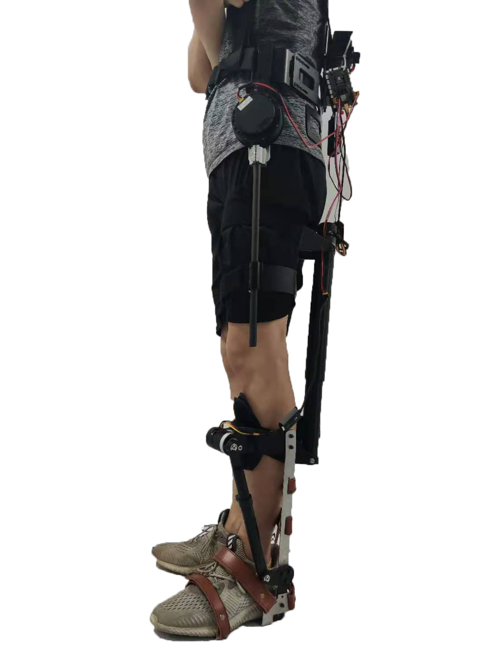
A Modular Rehabilitation Lower Limb Exoskeleton for Stroke Patients With Hemiplegia
Pengbo Li,Wenhao Wei,Ruoyu Bao,Bailin He,Zhilong Su,Can Wang and Xinyu Wu
Shenzhen Institute of Advanced Technology, Chinese Academy of Sciences,
Shenzhen
A modular exoskeleton robot,including an independent hip joint, knee joint and ankle joint.
Not cause additional harm to the human body.
SIAT-H meets the design requirements: light,modular, versatile, and suitable for left or right leg.
SIAT-H

