Slide 1
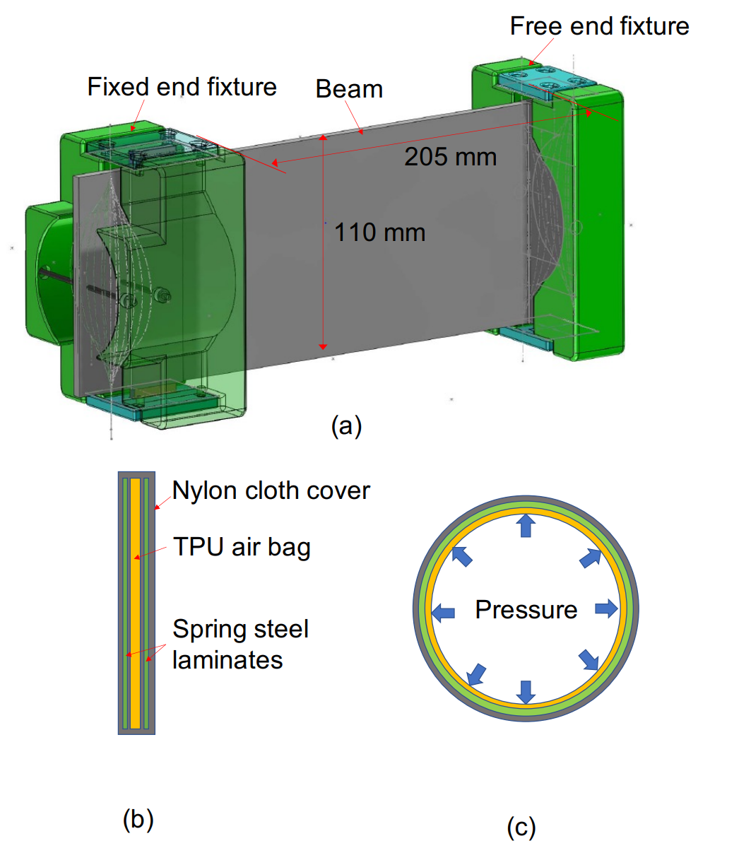
Hybrid Jamming Variable-Stiffness Link for Safe Co-Robots
Yitong Zhou
Shien-Ming Wu School of Intelligent
Engineering, South China University of Technology, China
Leon M. Headings and Marcelo J. Dapino
Mechanical and Aerospace Engineering, The Ohio
State University, USA
We propose a tunable stiffness mechanism for co-robot links based on hybrid jamming
It is made of multiple thin layers of spring steel and cloth, and an air bladder
Bending stiffness and cross-section area increases with air pressure
Around 66 times bending stiffness change is achieved
(0.26 to 17.42 N/mm)
3D rendering of a hybrid jamming beam

