Slide 1
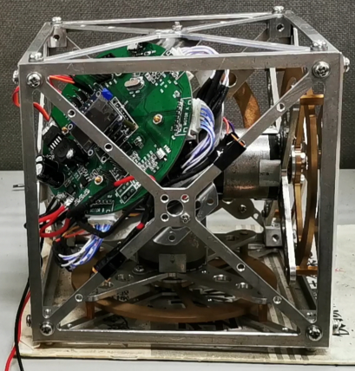
Research on Balance Control of Cube Robot
Qingsong Yin, Feifei Wang, Siliang Lu, Yuan Fan
College of Electrical Engineering and Automation, Anhui University, China
Yongbin Liu, Guoli Li
National Engineering Laboratory of Energy-Saving Motor and Control Technology, Anhui University,China
Mechanical structure of cube robot was design
State-space equation were derived from system dynamics modeling
The closed-loop state-space equation of robot system was simulated
Balance control of cube robot was tested and verified by the experimental setup.
A figure here
Experimental setup of cube robot

