Slide 1
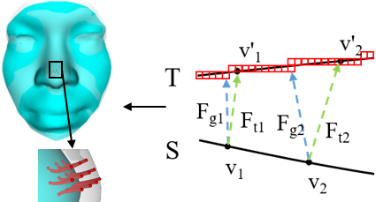
3D Facial Similarity Measure Based on Deformation Field
Jiajun Ma, Guoyuan Liang, Yu Liang, Xinyu Wu
Shenzhen Institute of Advanced Technology, Chinese Academy of
Sciences, China
Construct a composite deformation field based on distance transform and correspondence relationship.
Local similarity and global similarity are calculated based on smooth deformation path.
The similarity measurement results are in line with the expectation through experiments on the synthetic data and the real data.
The deformation process based on deformation field.
Notes:
Digest must be prepared in MS Office PowerPoint and we accept no other format.
Use Arial 28pt font in bold face for the title.
Use Arial 24pt font for the authors and Arial 20pt font their brief affiliations.
Use 3 or 4 bullet points (limit each to less than 15 words in Arial Narrow 24pt font), and only 1 figure (replace the figure on the right with your figure).

