Slide 1
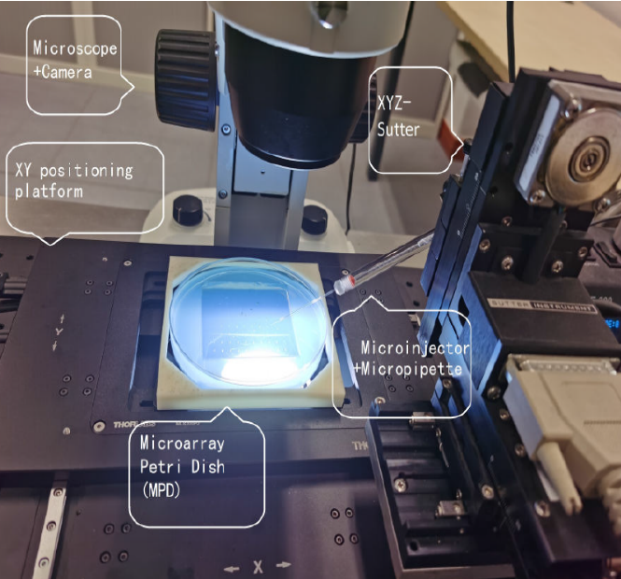
Design and Testing of an Automated Microinjection System for Batch Injection of Zebrafish Larvae
Ziqiang Chi, Qingsong Xu, Nana Ai, and Wei Ge
University of Macau, Macau, China
An automatic high-throughput microinjection system is designed and developed for the first time
It is applicable to batch injection of zebrafish larvae
Experimental results show that the system works fast and ensures stable success rate and survival rate for the fish larvae microinjection

