Slide 1
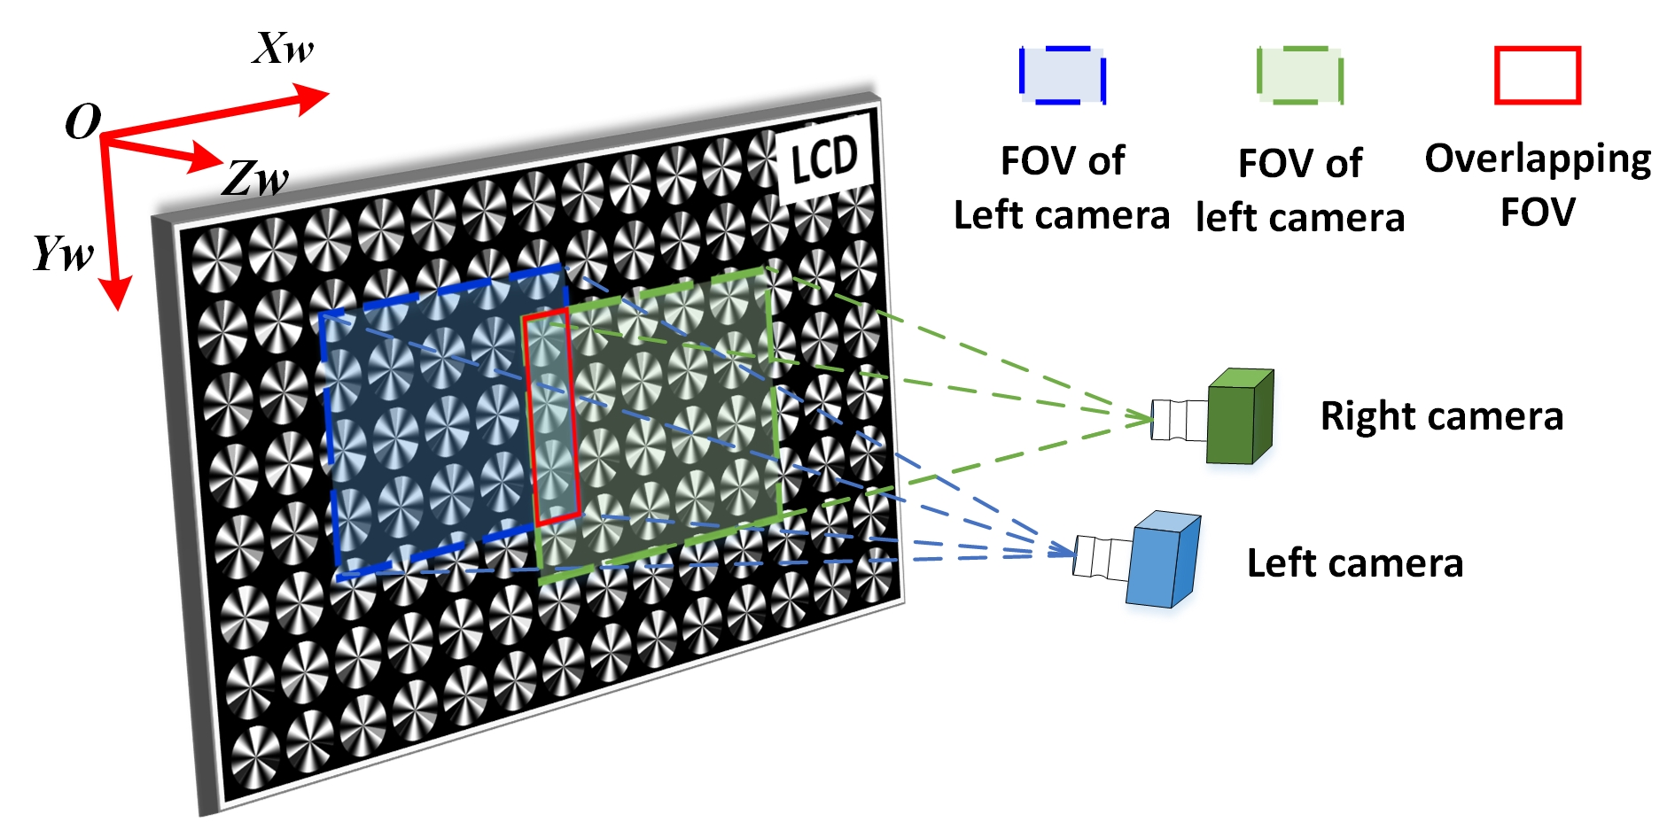
Stereo calibration of defocus cameras without the limitation of overlapping fields of view
Xiaokai Song and Xiangcheng Chen
School of Automation, Wuhan University of Technology, China
Wenyuan Liang
National Research Center for Rehabilitation Technical Aids, China
Each feature point is coded by the phase-coding method.
Stereo calibration can be realized even if the cameras are defocused.
Without the limitation of the cameras' overlapping fields of view.
Stereo calibration system

