Slide 1
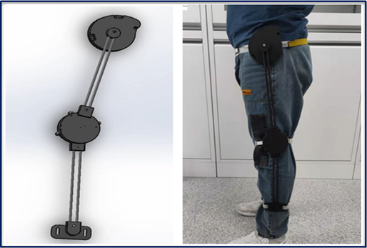
Lower Limb Exoskeleton Design Based on Knee Joint Assistance
Peng Jiang, Ye Wang, Tianqi Shao, Lin Wang, Guanglin Li
Institute of Advanced Integration Technology, Shenzhen Institute of Advanced Technology, Chinese Academy of Sciences, P.R.China
Propose a passive lower limb exoskeleton to benefit patients with knee dysfunction.
The effectiveness of the exoskeleton in assisting patients with walking dysfunction was verified using OpenSim simulation software.
It can help to regain the ability to walk with a natural gait by wearing this exoskeleton. Ultimately, it is hoped to improve the physical and mental health of patients.
A figure here

