Slide 1
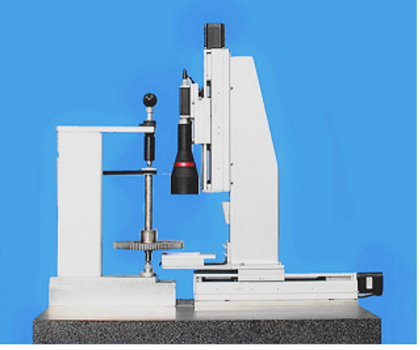
Measuring Method of Involute Profile Error Based on Machine Vision
ZHI Shan
College of Mechanical Engineering
Liaoning Institute of Science and Technology
China
A new algorithm for measuring involute tooth profile error based on machine vision with gear local image is proposed.
The gray image of gear is acquired by gear visual measuring instrument.
The center of gear positioning is determined by fitting the circle based on fixed radius least square method with constraints.
Gear vision measuring instrument

