Slide 1
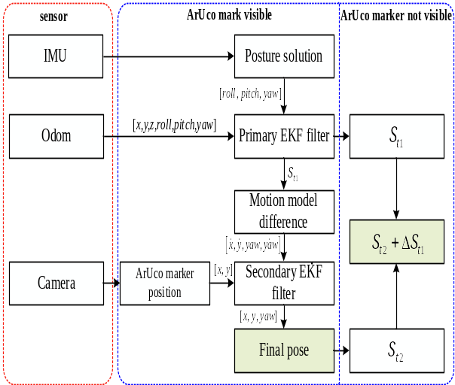
Multi-robot real-time cooperative localization based on high-speed feature detection and two-stage filtering
Zeyu Zhou, Wei Tang, Zenghui Wang, Lijian Wang, and Renyuan Zhang
Automation, Northwestern Polytechnical University, China
a high-speed feature detection and transformation method based on visual information is proposed.
a multi-robot cooperative localization method based on two-stage EKF is established for dynamic real scene.
a lightweight multi-robot information intersection mechanism is utilized to deploy the system in actual platform.
High-speed feature detection
and two-stage filtering

