Slide 1
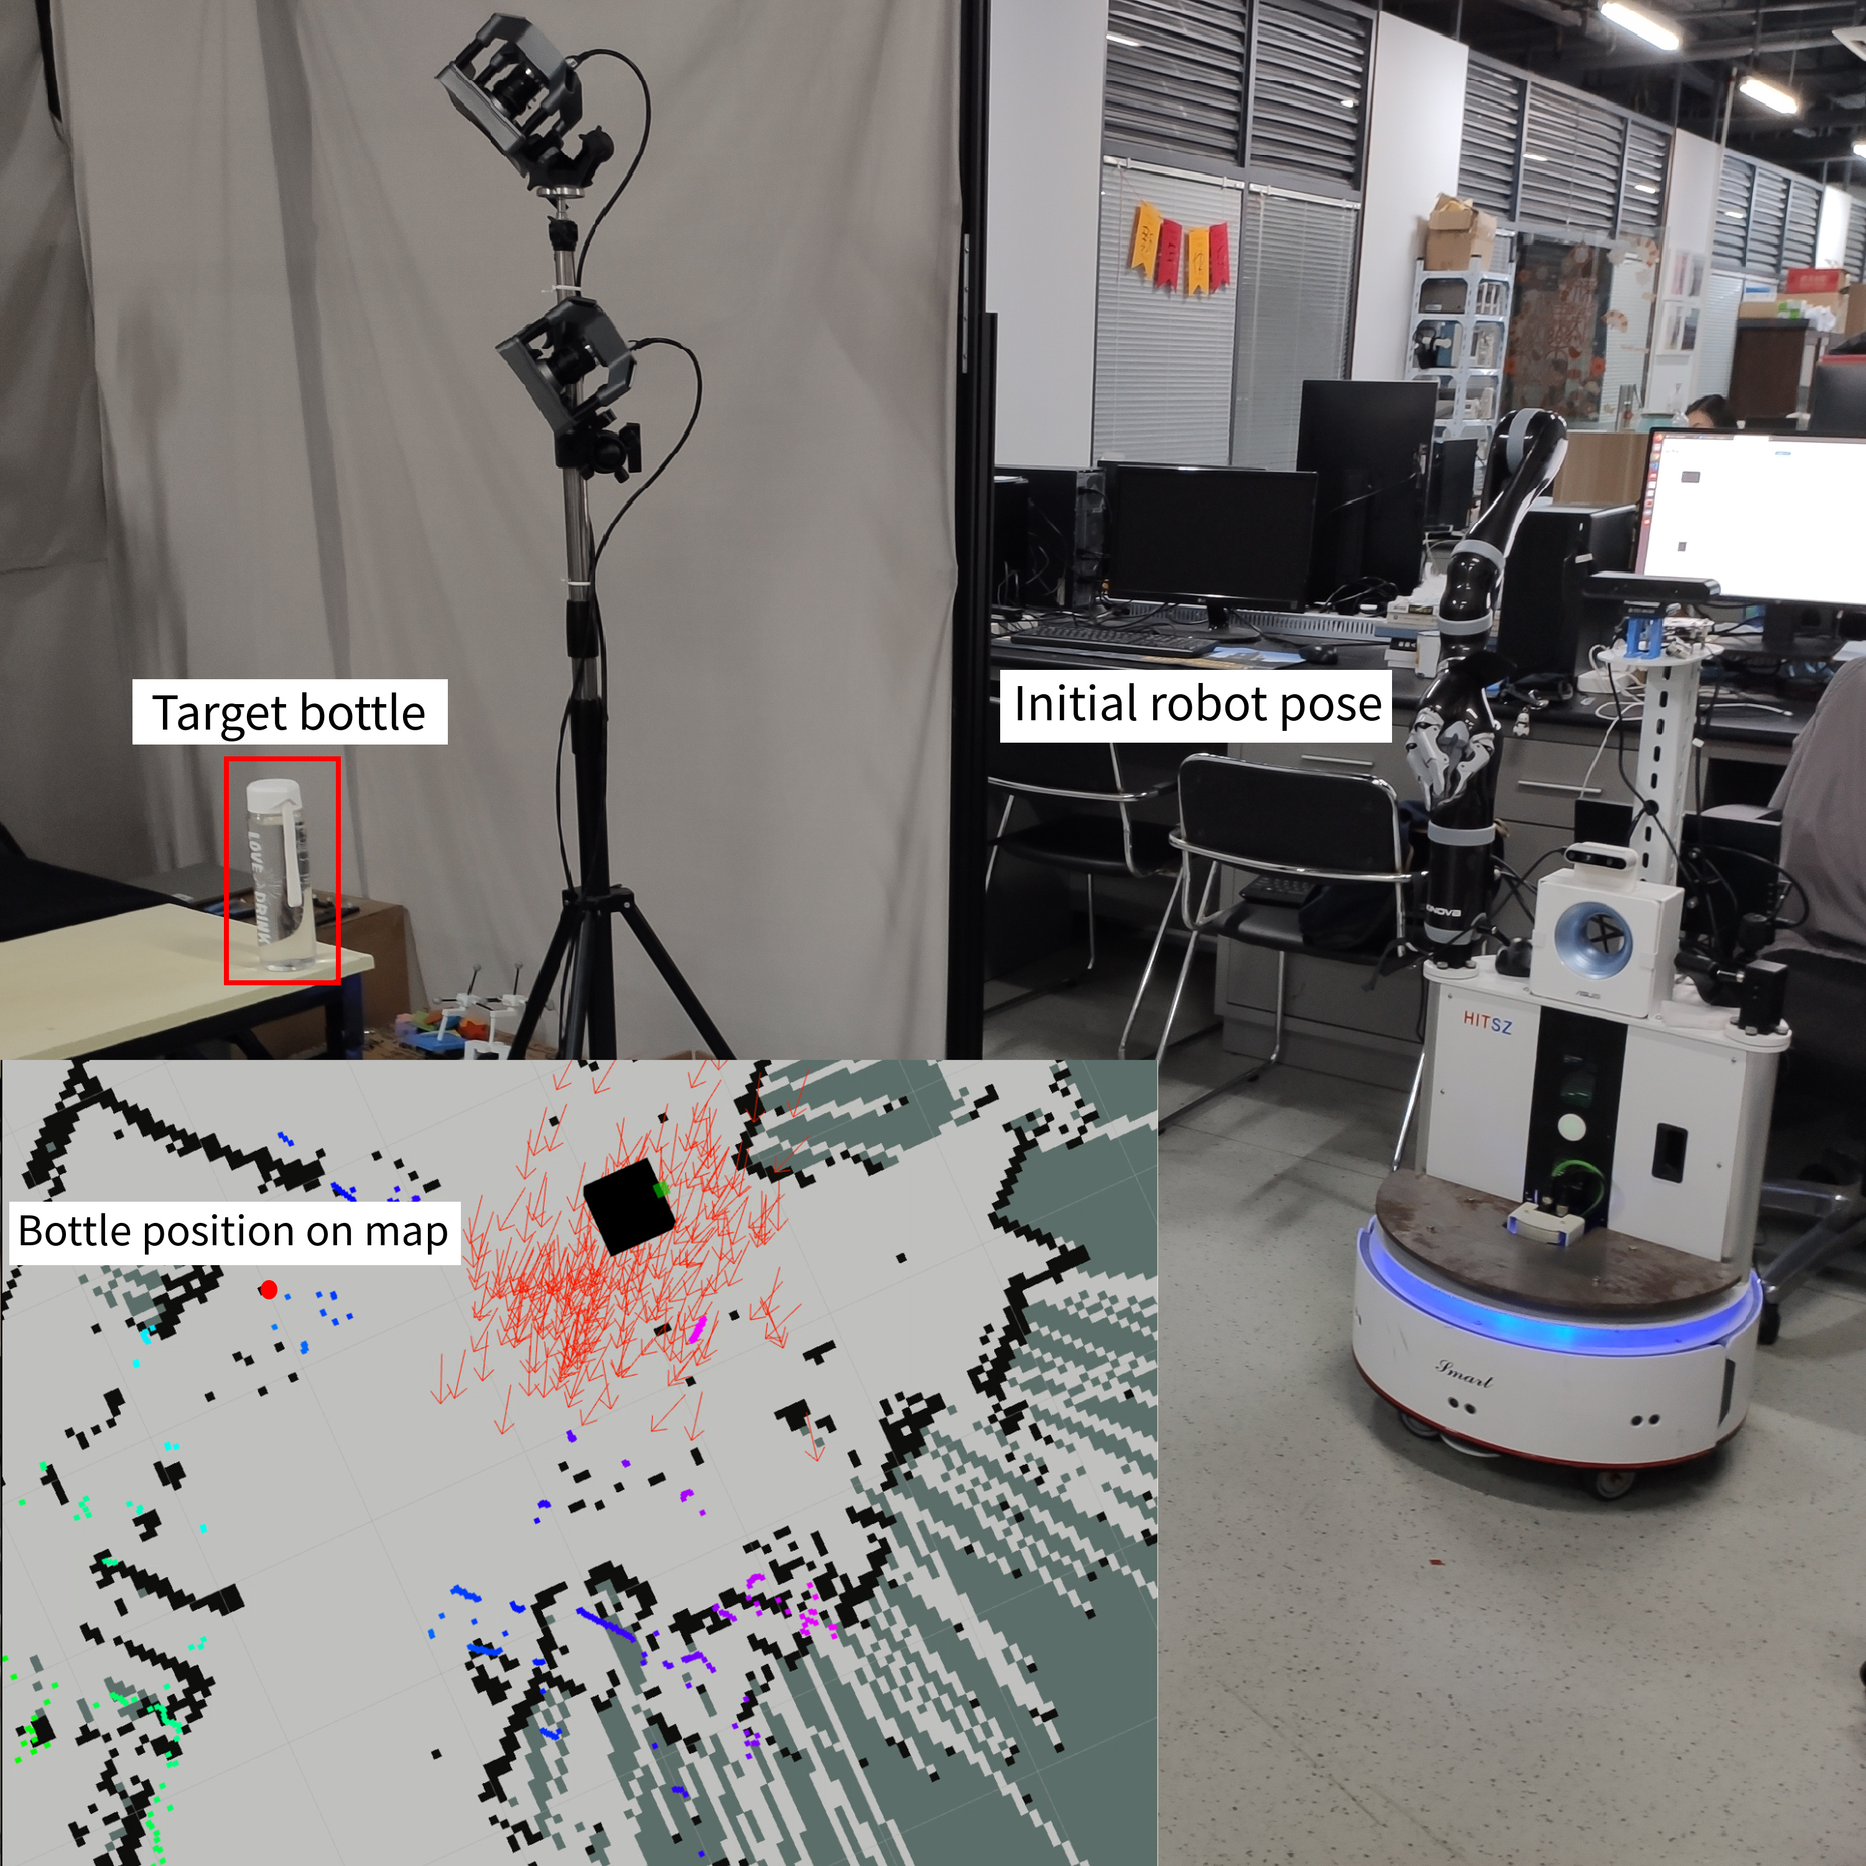
Uncertainty Aware Mobile Manipulator Platform
Pose Planning Based on Capability Map
Yuhao Meng, Yujing Chen and Yunjiang Lou
School of Mechanical Engineering and Automation, Harbin Institute of Technology Shenzhen, China
Mobile manipulator platform has great pose uncertainty in cluster and dynamic environment.
Find a platform pose with higher manipulability expectation under the uncertainty.
Use a uncertainty distribution based filter to the feasible platform poses.
Achieve higher manipulability expectation with less computing time increasement.

