Slide 1
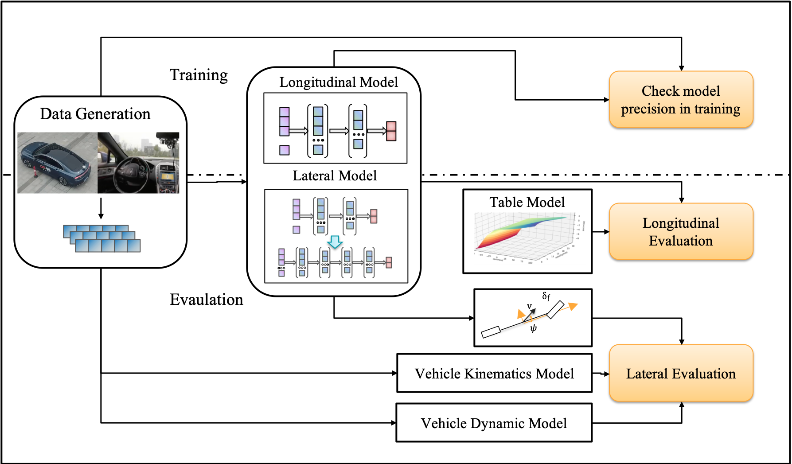
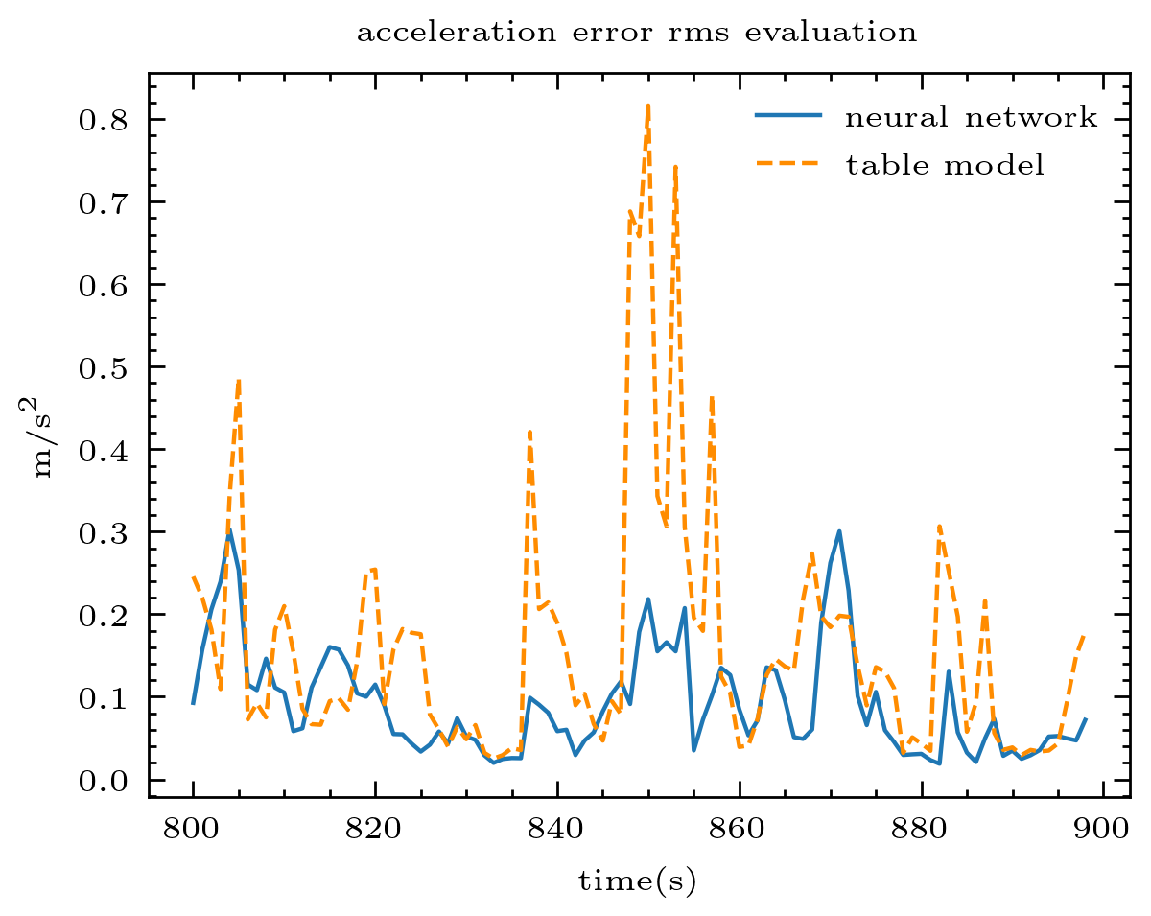
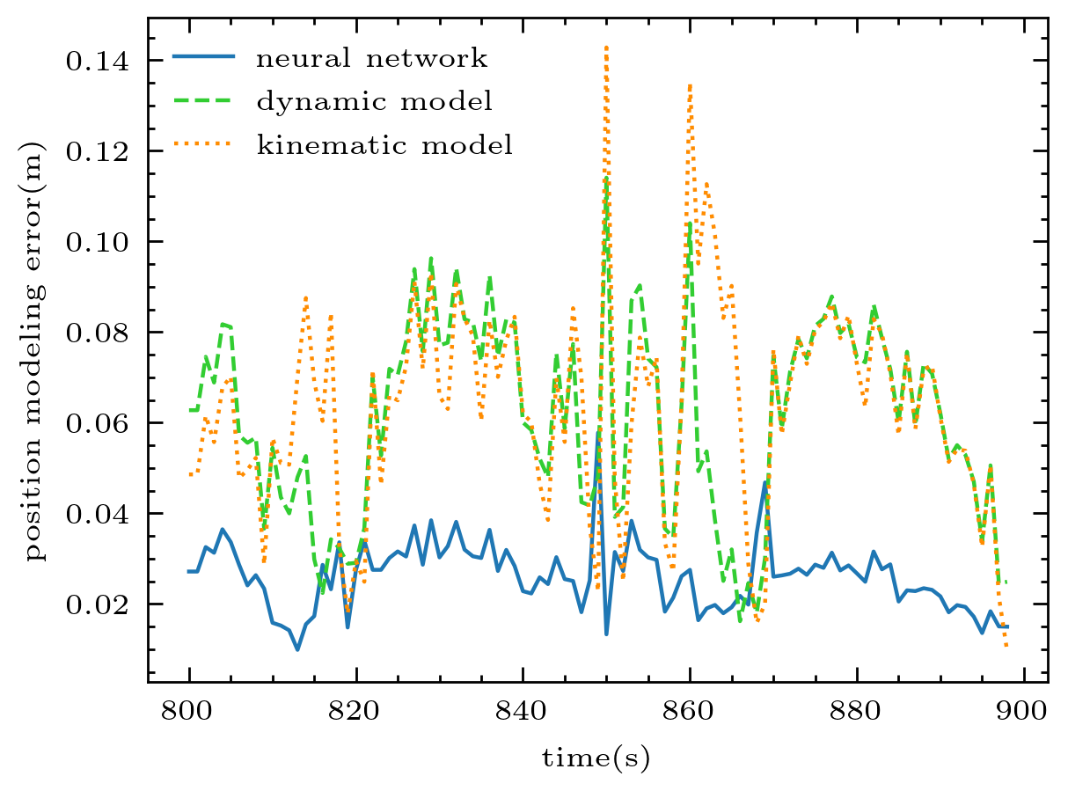
Vehicle Longitudinal and Lateral Dynamics Modeling by Deep Neural Network
Xiaoxu Cao, and Huiyun Li
Shenzhen Institutes of Advanced Technology, Chinese Academy of Sciences, China
Chunxiao Liu and Cong Qiu
SenseTime Group Limited, Shenzhen, China
A data-driven method based on neural network is proposed to build the vehicle longitudinal and lateral dynamics model.
The proposed network could learn the implicit dynamic model from the history data.
The longitudinal acceleration modeling precision could be improved by 40%. the lateral distance mean absolute error of the neural network model is 0.026m while the traditional method is about 0.06m.

