Slide 1
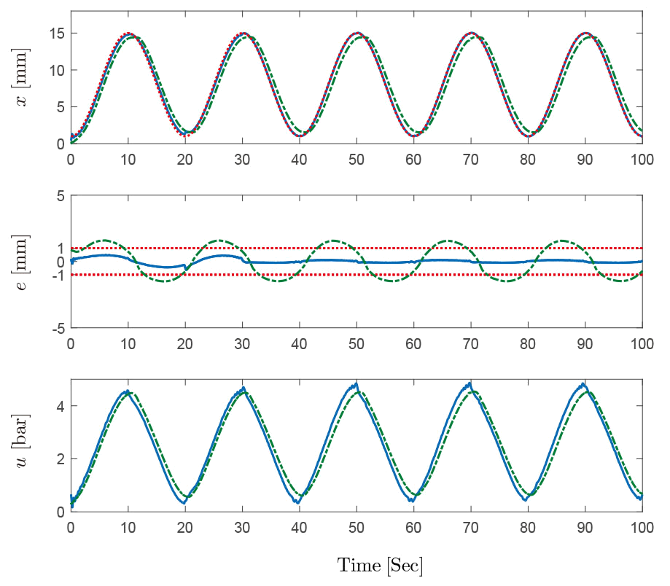
A Repetitive Learning Controller for PAM-Actuated Exoskeleton Robots With Motion Constraints
Tong Yang, Yiheng Chen, Ning Sun*, and Yanding Qin
Institute of Robotics and Automatic Information Systems (IRAIS), College of Artificial Intelligence, Nankai University, China
New repetitive learning-based error-constrained control for uncertain PAM-actuated exoskeleton robot systems
Accurate tracking control and effective error constraints
Asymptotic convergence of tracking errors by Lyapunov-based stability analysis

