Slide 1
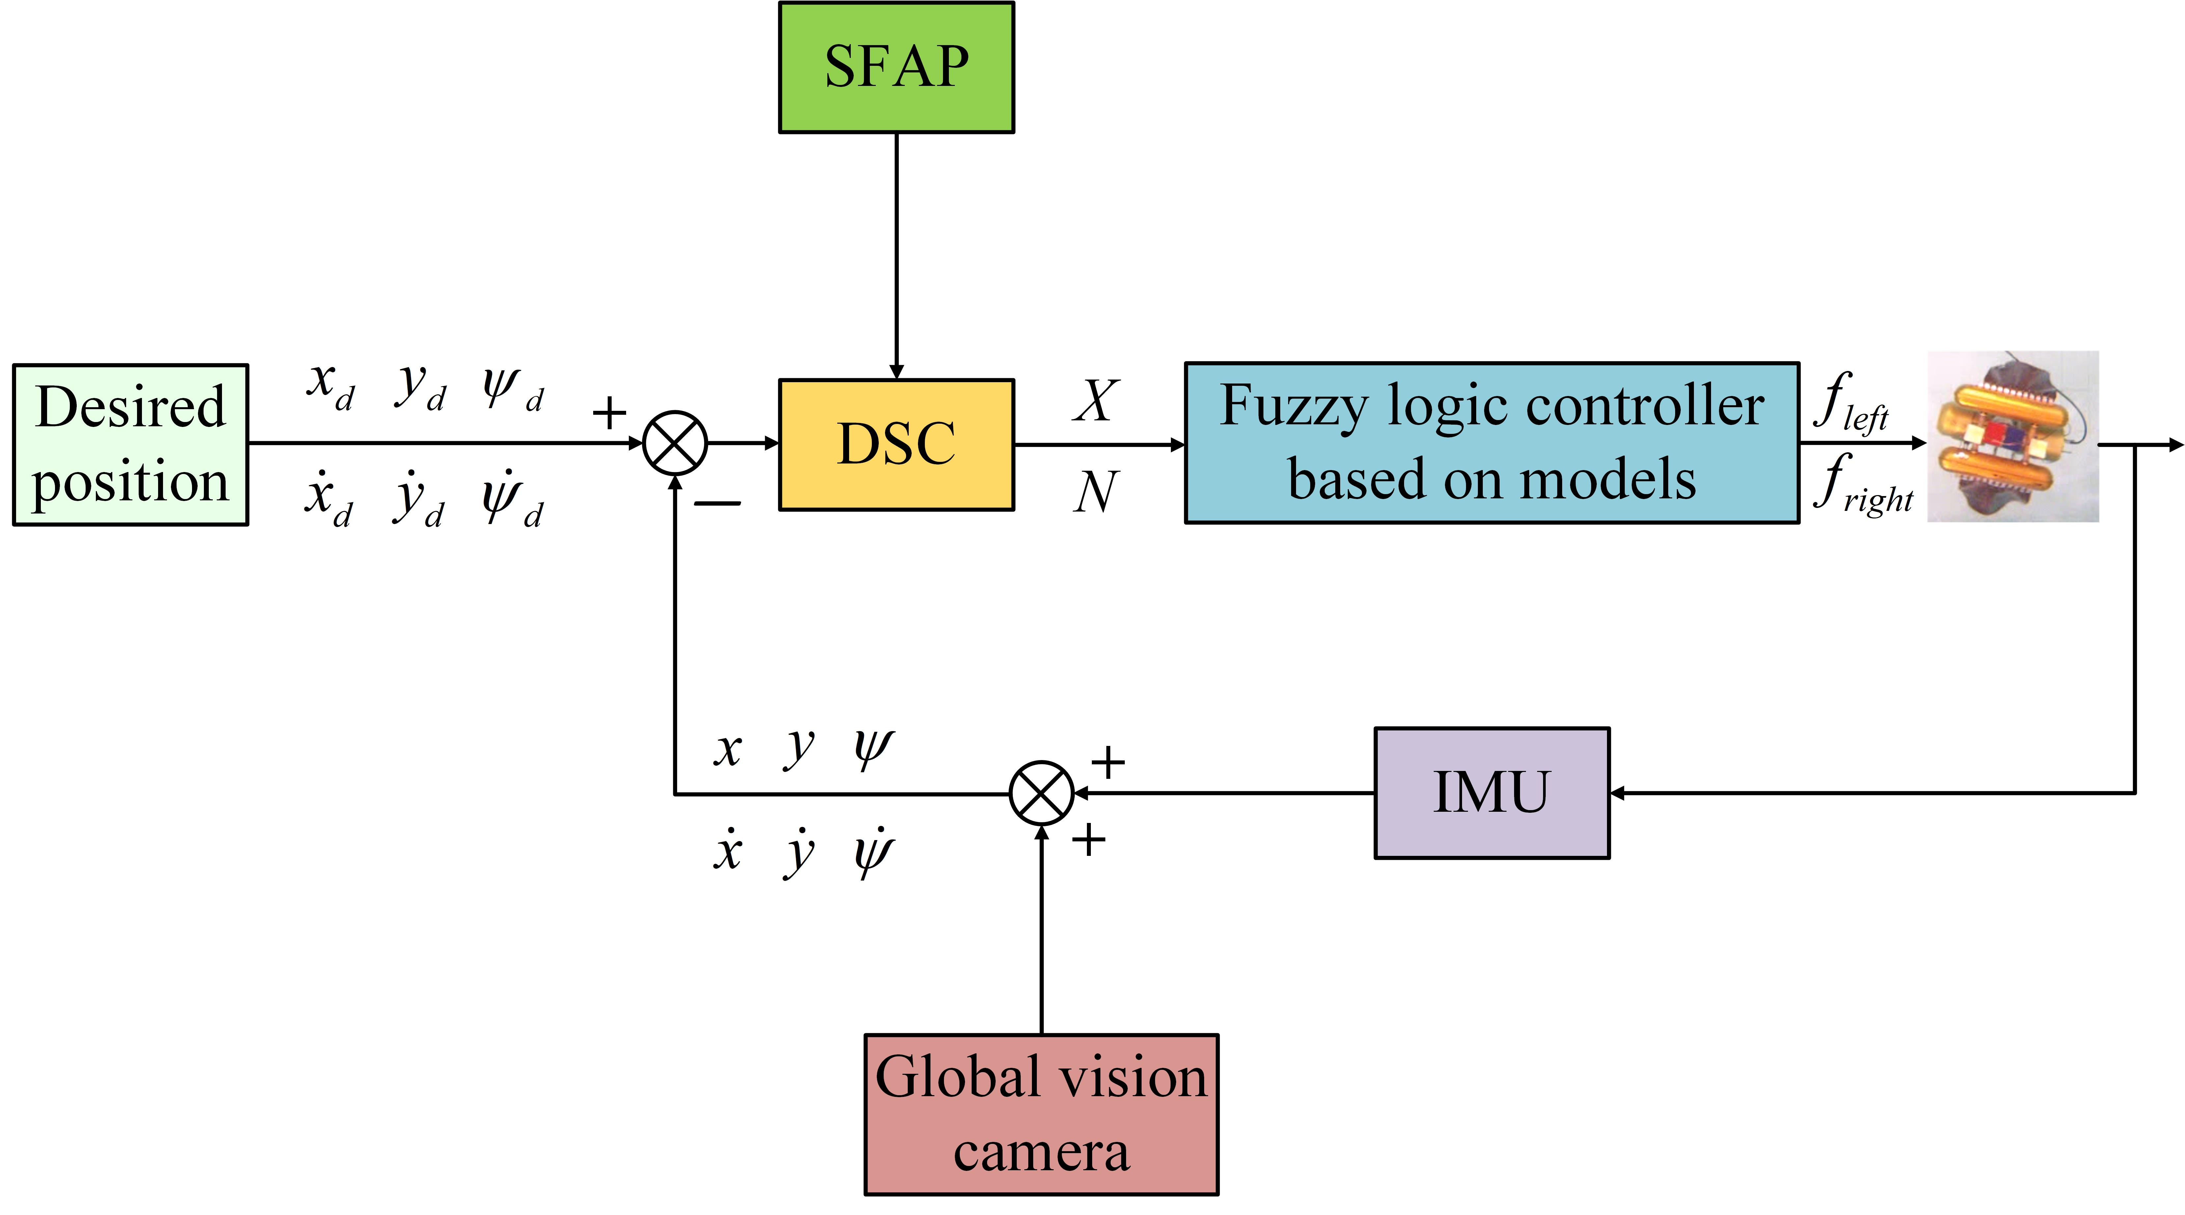
Dynamic Surface Control for an Underactuated Underwater Biomimetic Vehicle-Manipulator System
Xuejian Bai^{1,2}, Yu Wang², Rui Wang², Shuo Wang^{1,2}, Min Tan^{1,2}
¹School of Artificial Intelligence, University of Chinese Academy of Sciences, China
²State Key Laboratory of Management and Control for Complex Systems, Institute of Automation, Chinese Academy of Sciences, China
This paper proposes a position control method based an improved dynamic surface control.
A surge force adaptive process is designed to solve the underactuated problem of the UBVMS.
Simulations and experiments validate the control method’s feasibility and robustness in the application of UBVMSs.
Block diagram of the position control framework

