Slide 1
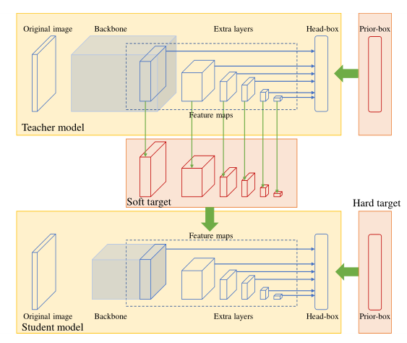
Feature Maps Training for Substation Defect Detection
Xingyu Yan, Yanqing Ma, Ning Wang, Yuxing He and Hui Cao
School of Electrical Engineering, Xi'an Jiaotong University, China
Jie Zhou
CGN New Energy Holdings Co., Ltd, China
Feature maps of complex networks are used in training.
a loss function is designed to meet different training targets.
Heat pixel is proposed in object detection to trade-off the background and the foreground.
This paper summarizes the common object detection requirements in substations and carries out experiments.
The overall structure of feature maps training

