Slide 1
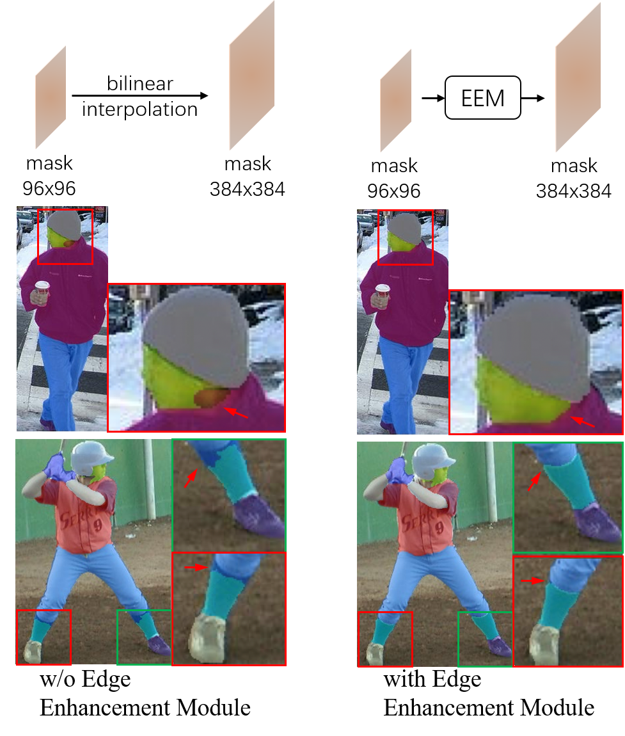
Human Parsing with Edge Enhancement
Lei Ma and Liqing Zhang
BCMI, Shanghai Jiao Tong University, China
Jian Wang and Jie Shao
AI Lab, ByteDance Inc., China
Focusing on enhancing body’s edge segmentation performance of the human parsing problem.
Three aspects: feature extraction, context embedding, and edge refinement.
Refining the body’s edges in the up-sampling procedures in a coarse-to-fine fashion.
Achieved excellent performance, mIoU 54.95% on LIP dataset, and mIoU 66.88% on PASCAL-Person-Part datasets.
Fig.1 Comparison of models w/o the edge enhancemen.

