Slide 1
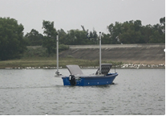
Theoretical and Experimental Study of Adaptive Control for Fixed-wing UAV Arrested Recovery on the USV
Lingling Chu and Feng Gu
Shenyang Institute of Automation, Chinese Academy of Sciences, China
Yuqing He
Shenyang Institute of Automation, Chinese Academy of Sciences, China
Shipborne recovery of fixed-wing UAV is an important technology for UAV.
An adaptive control method combined with LPV model and α - β filter for fixed-wing UAV arrested recovery.
Flight experiments under different conditions are completed to verify the performance of the controller.
The UAV with the proposed method can satisfy the requirements of recovery on the USV.
UAV
Recovery of UAV on USV
in real environment

