Slide 1
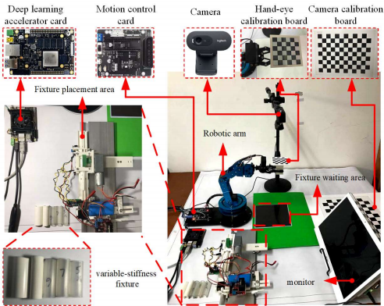
FPGA-based Deep Learning Acceleration for Visual Grasping Control of Manipulator
Haibin Yin*, Haiqing Hong and Jing Liu
Key Laboratory of Hubei Province for Digital Manufacture, School of Mechanical and Electronic Engineering, Wuhan University of Technology,China
Use FPGA to accelerate neural network.
Use Vivado and Petalinux development kit to build software and Hardware system.
Kinematic analysis enables the robot to grasp the target.

