Slide 1
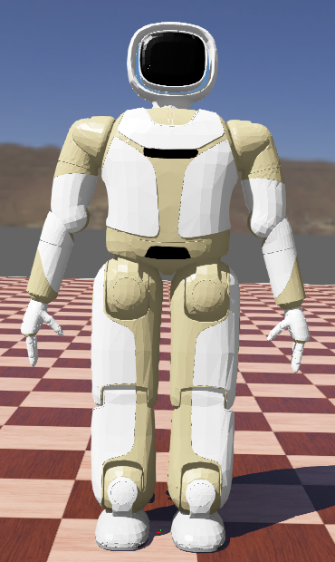
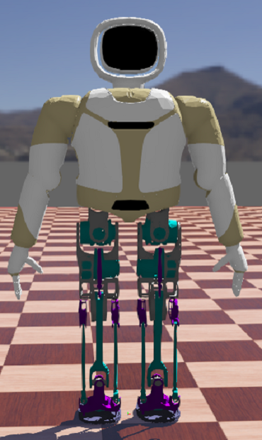
Effects of Backlash on the Walking Stability of Biped Robots
Yisen Hu, Hongyu Ding, Jingchen, Li, Wenguang, Wang and Jianxin Pang
UBTECH Robotics, Inc., Shenzhen, China
Xinyu Wu
Shenzhen Institutes of Advanced Technology, Chinese Academy of Sciences, Shenzhen, China
Dynamics simulation is used to analyze effects of backlash on walking.
Series-parallel mechanism works better than series mechanism under effects of backlash.
Coupled movement of knee and ankle joints reduces effects of backlash.
Simulation models

