Slide 1
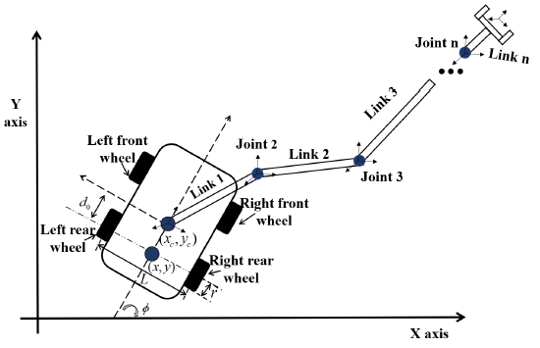
Kinematic control of mobile manipulators subject to physical constraints and noise disturbances
Xiaoxiao Li and Zhihao Xu and Xuefeng
Guangdong Key Laboratory of Modern Control Technology, Institute of Intelligent Manufacturing,GDAS, Guangzhou, Guangdong, P. R. China.
Shuai Li and Kanyang Jiang
School of Engineering, Swansea University, Swansea, United Kingdom
Li Jiang
School of Intelligent Manufacturing, Wuyi University, Guangdong, China
Considering the kinematic control of wheeled mobile manipulator subject to physical limits and external noise disturbances.
Proposing an HMOC scheme incorporating path following and physical constraints’ compliance based on the quadratic program.
Validating efficiency of the HMOC scheme and the designed solver via simulation.
Schematics of the wheeled mobile manipulator used in this study.

