Slide 1
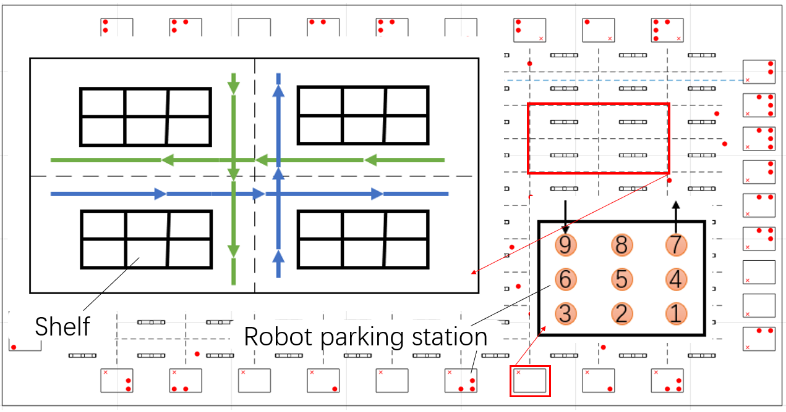
Task Allocation and Path Planning of Many Robots with Motion Uncertainty in a Warehouse Environment
YinBin Shi, Biao Hu and Ran Huang
College of Information Science and Technology, Beijing University of Chemical Technology, China.
The more robots are deployed, the higher efficiency logistics operation will be.
The decentralized auction-bid scheme is used to allocate tasks.
We take the robot’s motion uncertainty into account and predict the robot density.
We also design an effective scheme to sufficiently avoid the robot collision.
A figure here
Examples of robot parking stations and local roads, the arrow
indicates the passable direction

