Slide 1
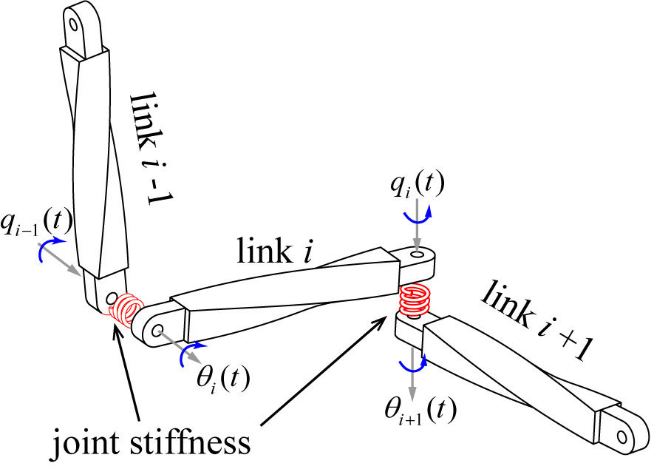
Dynamic Modeling and Vibration Analysis of a 6-DOFs Industrial Robot Considering Joint Flexibility
Guodong Shen¹, Sheng Xu^{1,2}, Chunjie Chen^{2,3} and Qiang Wang¹
¹Shandong Institute of Advanced Technology, Chinese Academy of Sciences, Shandong, 250102, P.R.China
²Guangdong Provincial Key Lab of Robotics and Intelligent System, Shenzhen Institute of Advanced Technology, Chinese Academy of Sciences, Shenzhen, 518055, P.R. China
³CAS Key Laboratory of Human-Machine Intelligence-Synergy Systems, Shenzhen Institute of Advanced Technology, Shenzhen, 518055, P.R. China.
This paper is concerned with the dynamic modeling and vibration analysis of multi-DOFs industrial robot considering joint flexibility.
A dynamic model based on Kane method is developed to analyze the vibration characteristics under different joint stiffness parameters.
The results of the proposed strategy can be used to design an accurate model-based controller for an industrial robot.
The schematic diagram of the joint flexibility

