Slide 1
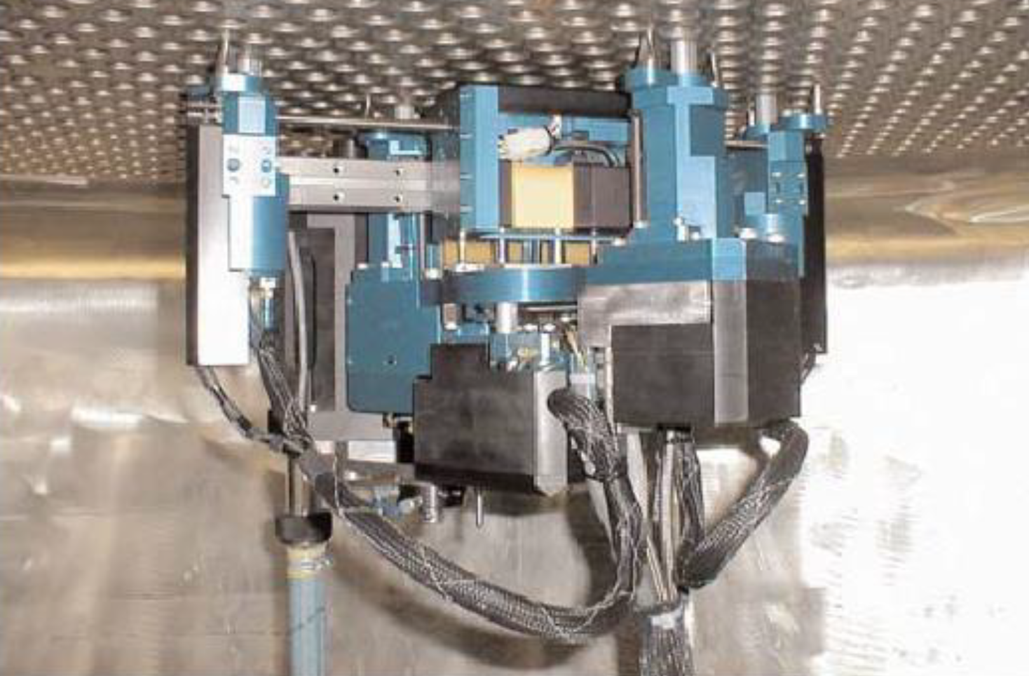
Research status and Development trend of Inspection Robot for Steam Generator Heat Transfer Tubes
Kuan Zhang, Biying Xu, Zhenming Xing, Jie Zhao, Jizhuang Fan*
State Key Laboratory of Robotics and System,
Harbin Institute of Technology, China
The key technologies are analyzed in detail.
Summarize the existing problems and challenges.
Prospects the future development trend.
Pegasys works on the tube sheet

