Slide 1
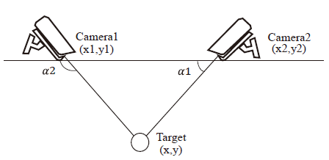
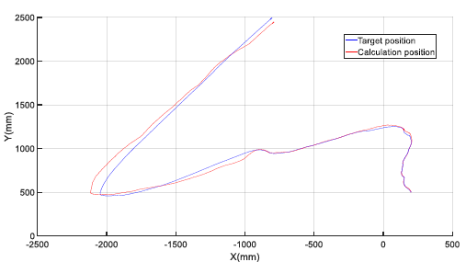
An Invasive Target Detection and Localization Strategy Using Pan-tilt-zoom Cameras for Security Applications
Jia Hu¹, Chuanshen Zhang^{1,2}, Sheng Xu^{1,3*}, Chunjie Chen^{3,4}
¹Shandong Institute of Advanced Technology, Chinese Academy of Sciences, Shandong, 250102, China
²School of Physics Science and Information Techongy, Liaocheng University, Liaocheng, 252000, China
³Guangdong Provincial Key Lab of Robotics and Intelligent System, Shenzhen Institute of Advanced Technology, Shenzhen, 518055, China
⁴CAS Key Laboratory of Human-Machine Intelligence-Synergy Systems, Shenzhen Institute of Advanced Technology, Shenzhen, 518055, China
This paper designs a practical security monitoring system to quickly detect and localize the invasive animals.
To resolve the inaccurate and time-lag problems in the target recognition, a strategy combined with YOLOV5 and DeepSOPT is developed.
Furthermore, an improved PID controller using particle swarm optimization (PSO) is proposed to control the PTZ for target localization.

