Slide 1
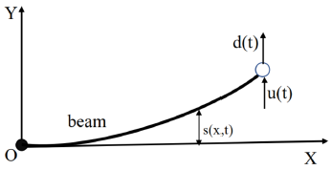
Adaptive Vibration Iterative Learning Control of a Flexible Beam via Backstepping Technique
Yu Liu, Xiaoqi Wu and Yanfang Mei
Automation Science and Engineering, South China University of Technology, China
Yilin Wu
Computer Science, Guangdong University of Education, China
Euler-Bernoulli beam system

