Slide 1
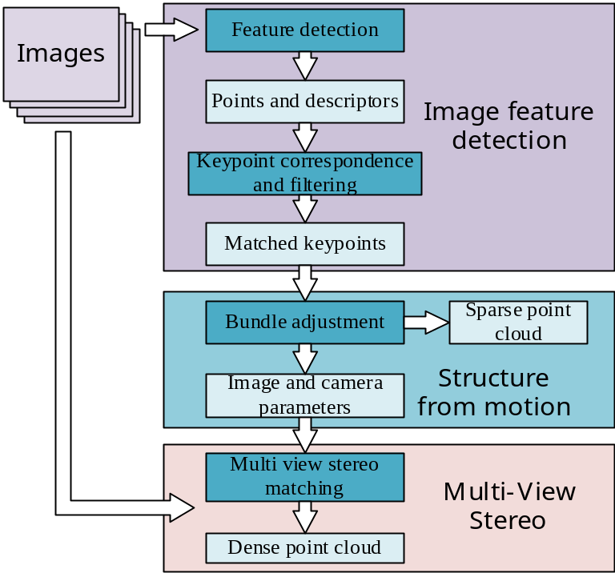
Virtual reality navigation system of nasal endoscopy with real surface texture information
Z. Cui¹³, Y. He¹, P. Zhang¹, Y. Hu¹, H. Jin², S. Liu³
1-Shenzhen Institute of Advanced Technology, Chinese Academy of Sciences
2-Shenzhen Broadcare medical robotics co. Ltd., Shenzhen, China
3-Harbin Institute of Technology, Shenzhen, China
3D reconstruction of nasal cavity based on monocular nasal endoscopic images
Variable-scale registration of monocular reconstruction model and CT model
Collision-free path planning of nasal endoscope under the anatomical constraints of nasal cavity
Experiments and discussion
Flow chart of nasal 3D reconstruction

