Slide 1
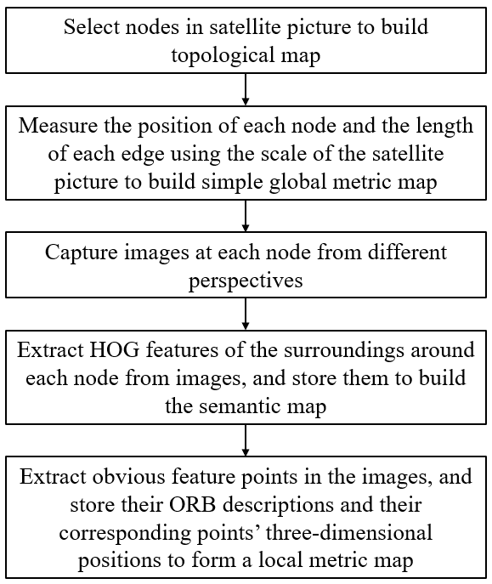
A Hierarchical Semantic Map for Large-scale Outdoor Environment
Di Zhang and De Xu
Research Center of Precision Sensing and Control, Institute of Automation, Chinese Academy of Sciences, Beijing
Make full use of the pre-known knowledge of environment.
Use HOG features of landmarks to store semantic information.
Use ORB feature points and their 3D position to form the local metric map.
Build topological map, simple global metric map, semantic map, and local metric map.
A figure here
For figure caption (optional), use arial narrow 20pt font

