Slide 1
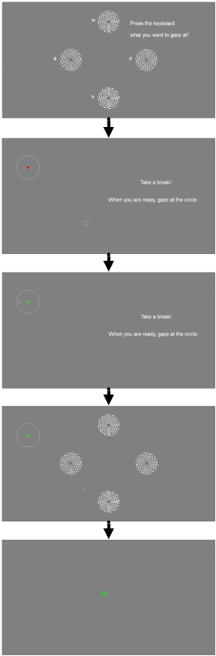
Asynchronous steady-state visual evoked potential brain-computer interface application: True and false positive rate comparison between with and without eye-tracking switch paradigms
Jun Xie and Huanqing Zhang
School of Mechanical Engineering, Xi’an Jiaotong University, China
This paper proposed eye-tracking switch based asynchronous BCI paradigm to reduce the false positive rate.
Results showed that the false positive rate was reduced to less than 10%.
Meanwhile, the recognition accuracy can also be improved to a certain extent.

