Slide 1
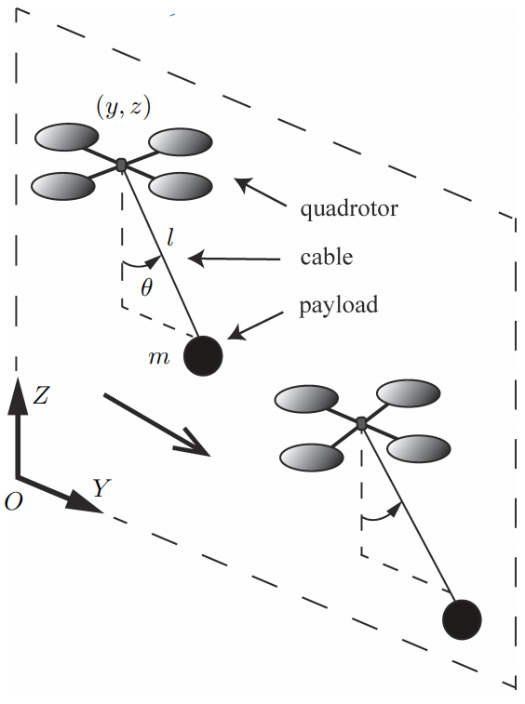
Adaptive Neural Network Control of Quadrotor Unmanned Aerial Vehicle Transportation Systems
Xiao Liang, Zhuang Zhang, Hai Yu, Yang Wang, Ning Sun
Institute of Robotics and Automatic Information Systems, College of Artifificial Intelligence, Tianjin Key Laboratory of Intelligent Robotics, Nankai University, Tianjin 300350, China
An adaptive controller is proposed based on sliding manifolds and RBFNNs.
RBFNNs are utilized to compensate for system uncertainties/disturbances.
The stability of the system can be guaranteed by Lyapunov techniques.
Simulation results show superior performance and robustness of the proposed adaptive NN controller
The quadrotor UAV transportation system

