Slide 1
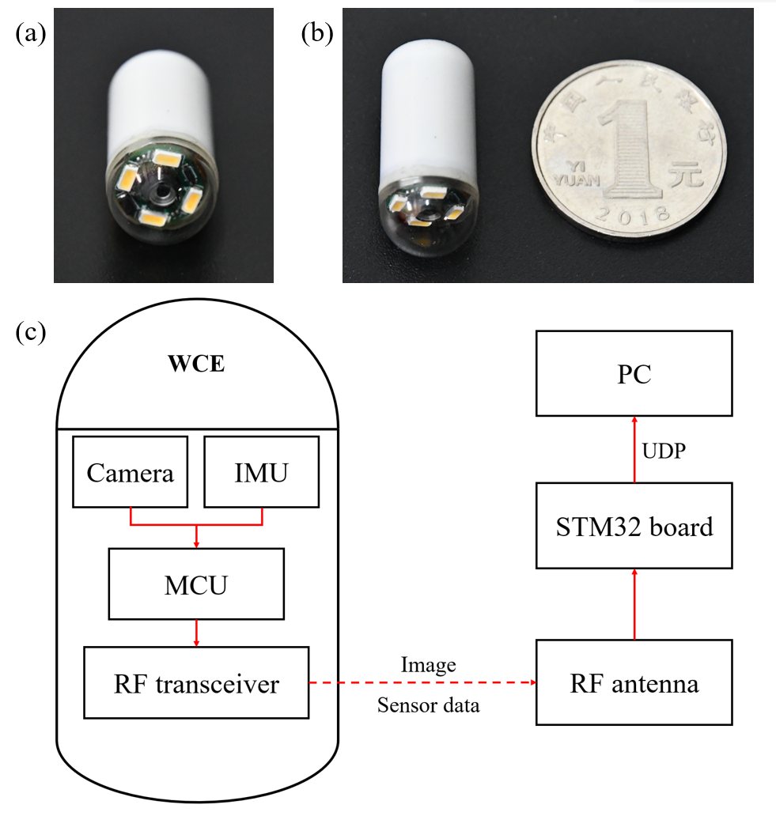
Real-time Attitude Tracking of Capsule Endoscope Based on MEMS IMU and Error Analysis
Zhuokang Huang and Chengzhi Hu
Department of Mechanical and Energy Engineering, Southern University of Science and Technology, China
A method for calculating the attitude of WCE based on MEMS IMU is implemented.
The accuracy of attitude tracking is measured by a series of experiments.
The experimental results show that the method meets the requirements in about six minutes.
Additionally, we propose a method to improve the attitude accuracy by reciprocating the rotational motion.
A figure here
(a) (b) The WCE we uesd and (c) system frame diagram of WCE.

