Slide 1
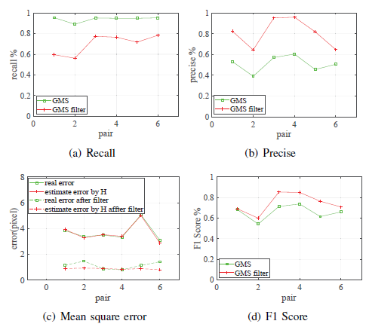
Estimating Pose of Object and Manipulator Grasping Control
Dong Wang, Dong Yang, Qinghui Pan, Chaochao Qiu,
Yongxiang Dong, Jie Lian
School of Control Science and Engineering, Dalian University of Technology, China
Using the RANSAC algorithm and affine invariant principle to filter out false match pairs based on GMS algorithm.
Combined with depth image, The least square SVD method is used to solve the rotation and tra nslation matrix of the object. We use this matrix to estimate the pose of object.
The control of the end effector based on the projection angle has good experimental results
A figure here
For figure caption (optional), use arial narrow 20pt font

