Slide 1
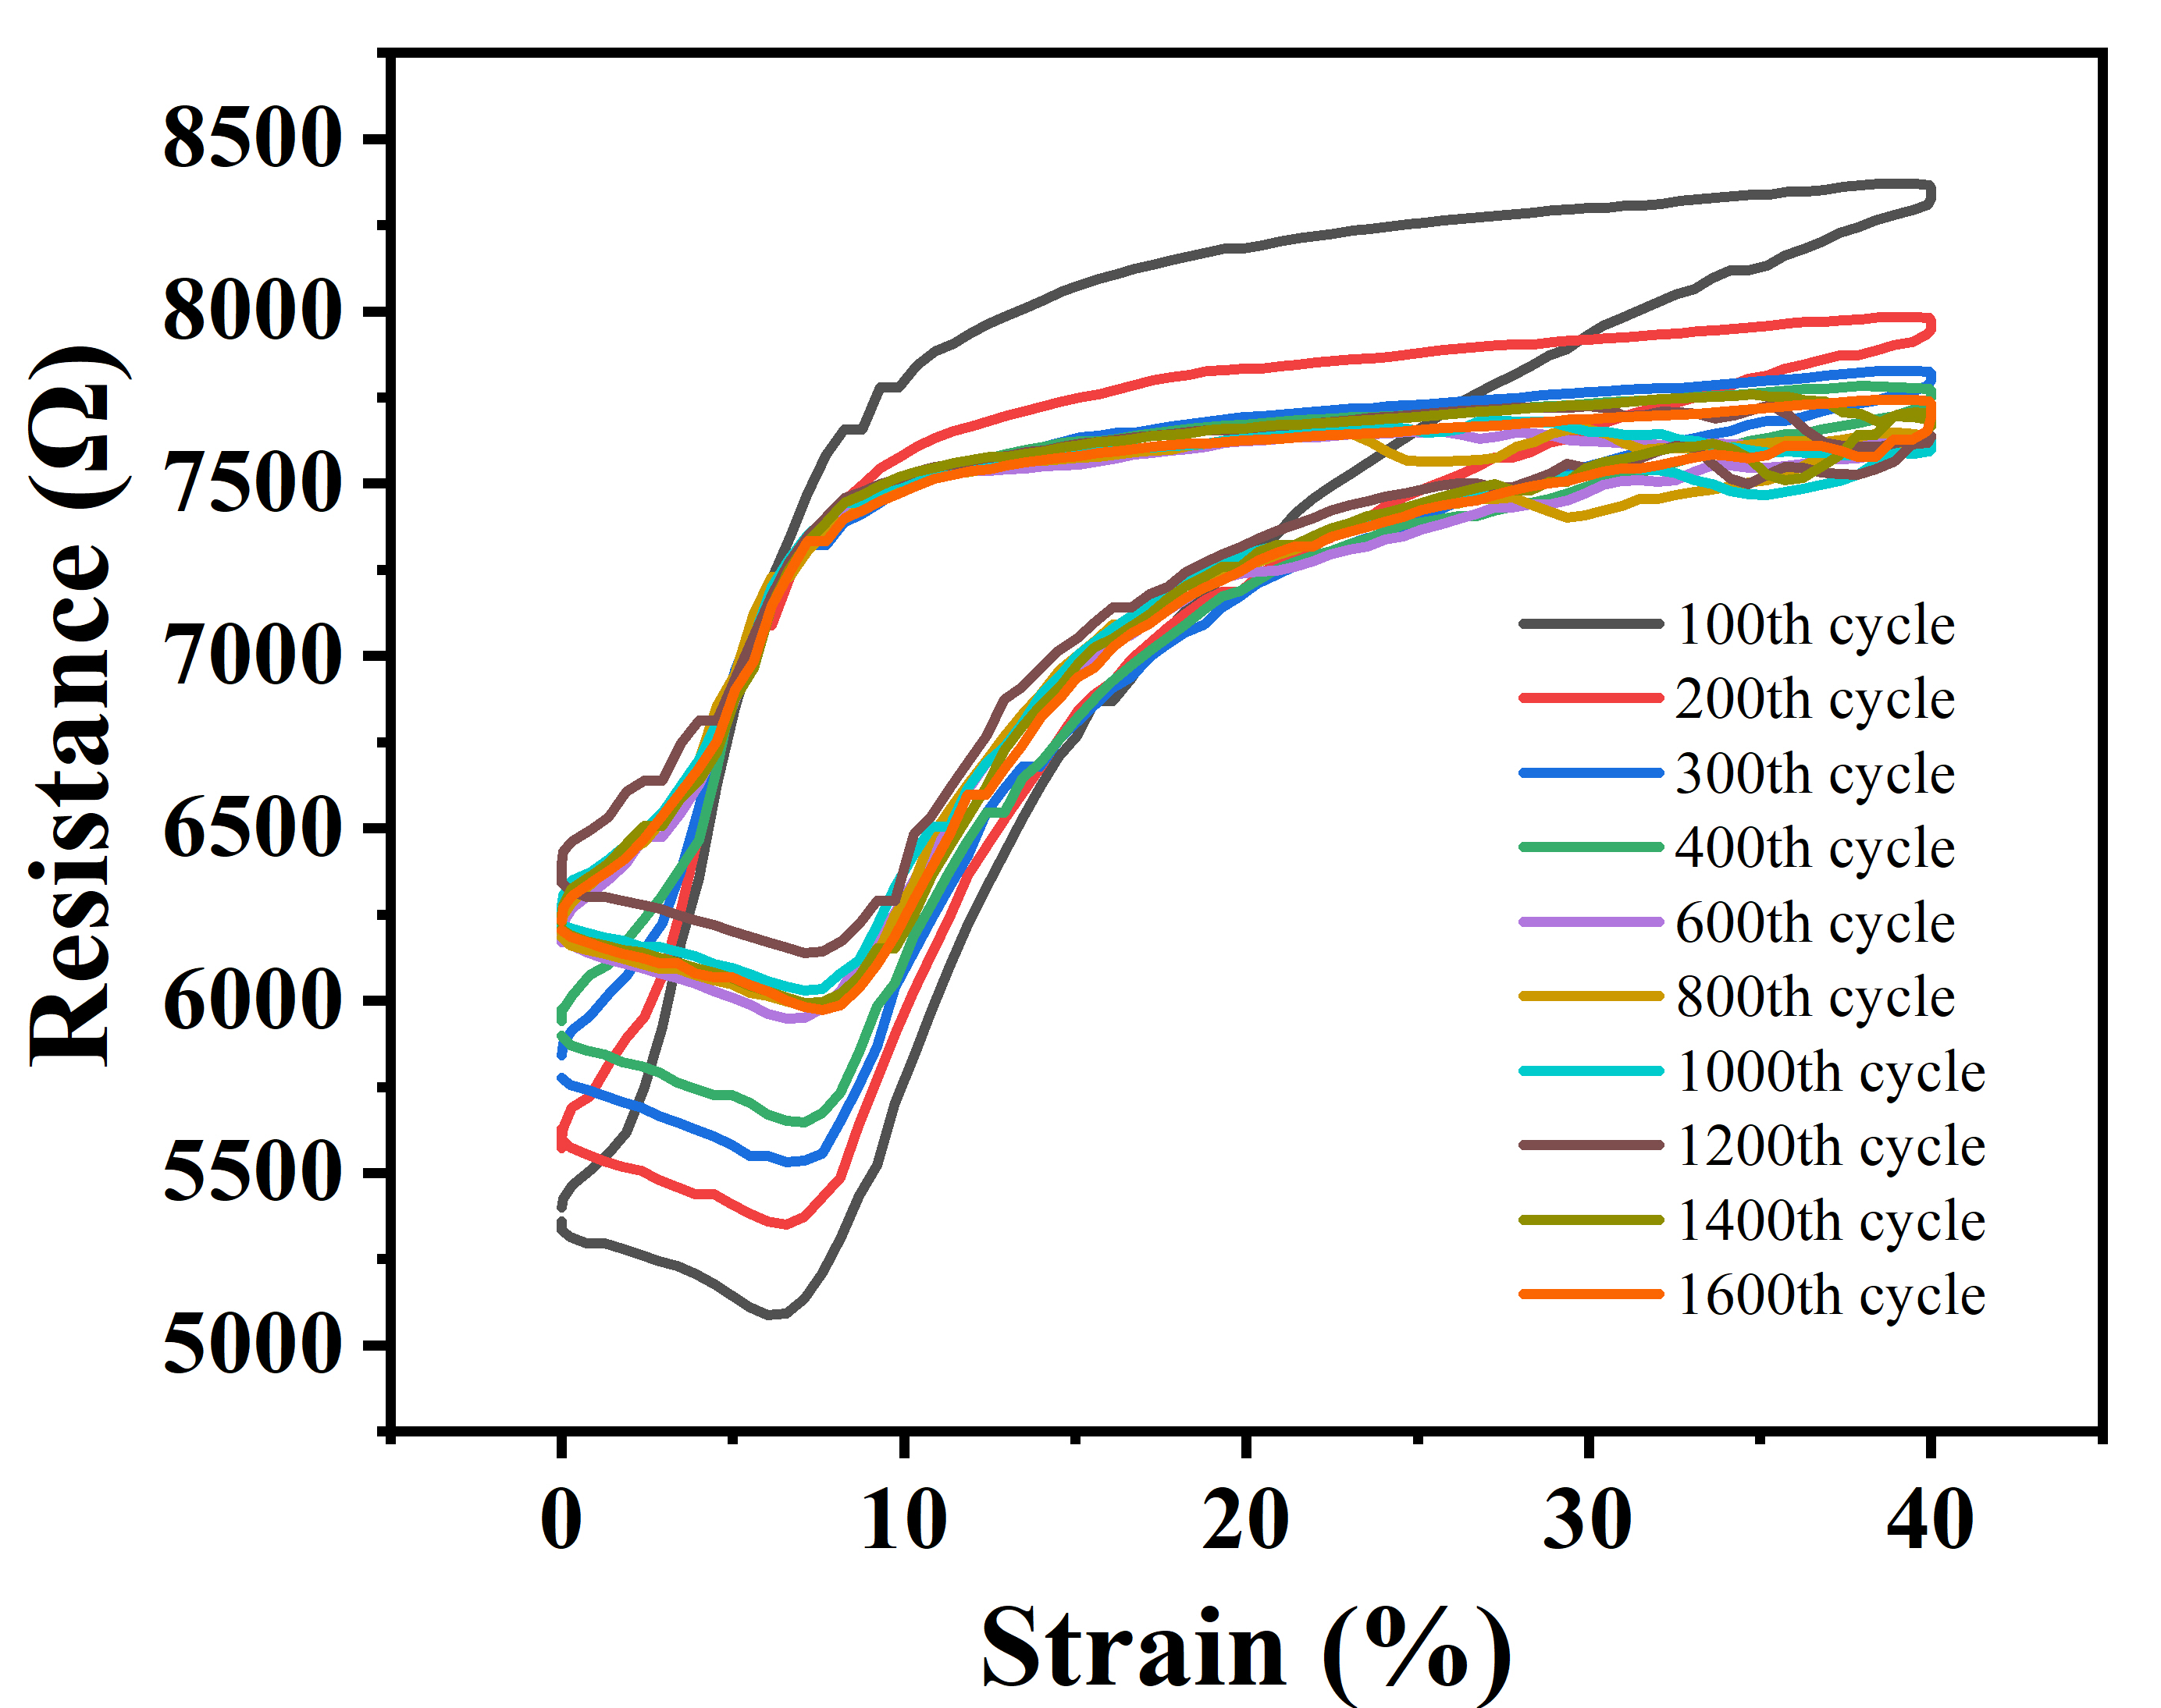
Cycle stability of flexible stretchable electrode
Jing Sun, Qingsong Li, Rui Su, Hang Zhao, Guanglin Li*, Zhiyuan Liu*,
Neural Engineering Center
Shenzhen Institutes of Advanced Technology, Chinese Academy of Sciences
1068 Xueyuan Road, Shenzhen 518055, China
The gold film electrode produces small cracks
The resistance of the flexible stretchable electrode generally decreases during 1 to 600 cycles
the resistance change is not large after 600 cycles
combining Au with a flexible substrate is an excellent way to prepare flexible electrode
Tensile performance of gold film electrode 100-1600 cycles

