Slide 1
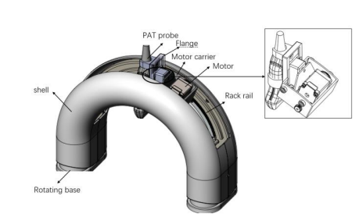
Design of scanning robot for atherosclerosis detection via photoacoustic imaging
Yongjian Zhao, Yuting Shen, Fei Gao
School of Information Science and Technology, ShanghaiTech University
Li Liu
Department of Electronic Engineering, the Chinese University of Hong Kong, Hong Kong, China
Designing a rotating scanning robot for photoacoustic imaging of cervical atherosclerosis.
It can replace the doctor's manual inspection. Play the role of liberating hands.
Photoacoustic imaging has been applied as a perception of this Robot.

