Slide 1
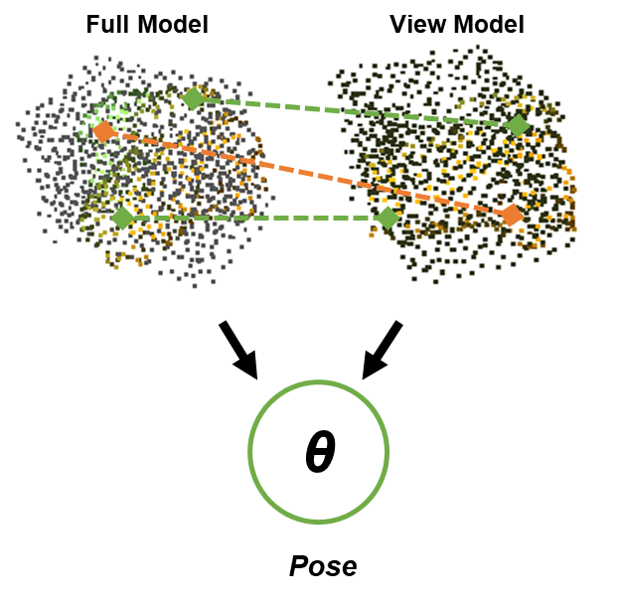
Unseen Object Pose Estimation
via Registration
Jun Wu, Yue Wang and Rong Xiong
Control Science and Technology, Zhejiang University, China
Current object pose estimation methods mostly rely on instance specific features, which limits their ability to generalize to unseen objects.
3D geometrical construction is embedded in observation, yet commonly neglected.
We reconstruct full model and view model from reference and query observation, then seek for probabilistic correspondence between them to solve registration problem.
Our method achieves comparable performance with SOTA, with accuracy and efficiency

