Slide 1
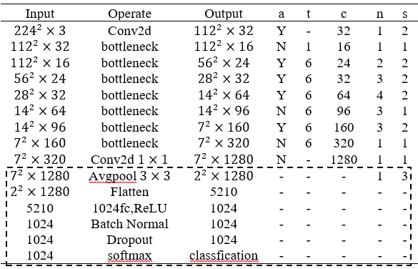
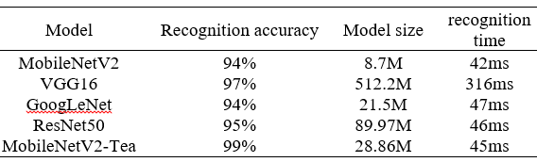
Rapid identification method of fresh tea leaves based on lightweight model
Zhonghui Chen, Dengzhun Wang,Hongbo Fang, Guang Wang , and Benliang Xie
College of Big Data and Information Engineering, Guizhou University, China
e-mail: blxie@gzu.edu.cn
By improving the MobileNetV2 network, the MobileNetV2-Tea model has obtained
Depth-separable convolutional structure has less the computation of parameters
Using attention optimization module
builting anew average pooling layer and a new fully connected layer
MobileNetV2-Tea model
A figure here
Model Comparasion

