Slide 1
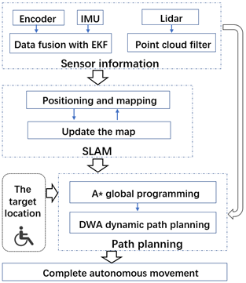
Research on Autonomous Movement of Nursing Wheelchair Based on Multi-sensor Fusion
Yingbing Su, Huarui Zhu, Zhou Zhou, Bingshan Hu, Hongliu Yu School of Medical Instrument and Food Engineering, University of Shanghai for Science and Technology, China
According to the mobile needs of semi-disabled patients, an intelligent nursing wheelchair was designed.
Fusion of multiple sensor information to improve positioning accuracy.
Realize the autonomous movement of wheelchair and improve its intelligence and interactivity.
Wheelchair software framework

