Slide 1
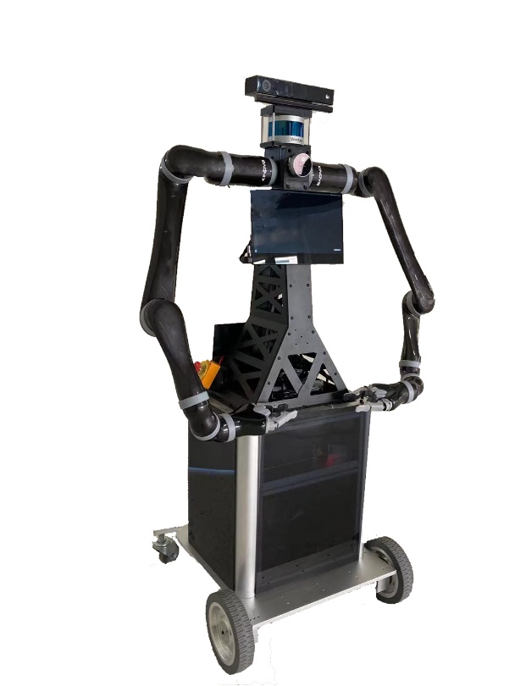
Workspace Analysis of a Dual-arm Mobile Robot System for Coordinated Operation
Yue Meng, Ziqi Zhao, Weinan Chen, Xiao Xiao, and
Max Q.-H. Meng
Department of Electronic and Electrical Engineering,
Southern University of Science and Technology, Shenzhen, China
The mechanical and software structure of dual-arm mobile robotic system is introduced;
D-H method is used to establish forward kinematics of the robotic arm;
The workspace is analyzed by Monte Carlo method. The shape and boundary of the workspace is provided;
Cooperative operation with the dual-arm is demonstrated.
Laser sensor
Vision sensor
Left arm
Right arm
Frame
Control & processing module
Wheeled chassis

