Slide 1
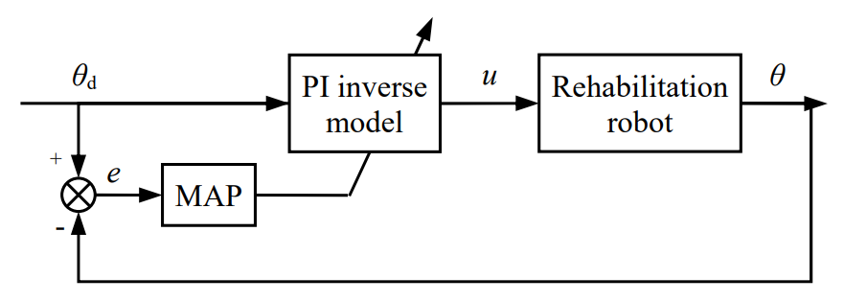
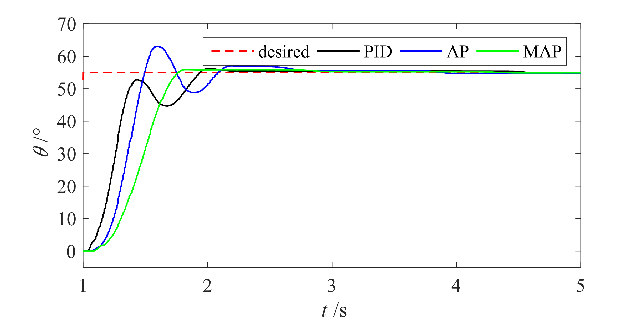
Hysteresis Compensation of an Elbow Joint Rehabilitation Robot Featuring Flexible Pneumatic Artificial Muscle Actuation
Yuankai Xu, Yanding Qin, Jianda Han
College of Artificial Intelligence, Nankai University, China
A PAM actuated robot is developed for the elbow joint rehabilitation and movement assistance
Direct inverse modeling method is utilized to obtain the inverse hysteresis model of the system
A modified AP algorithm is used to dynamically update the weights of the inverse model
Block diagram of the controller and experiments results

