Slide 1
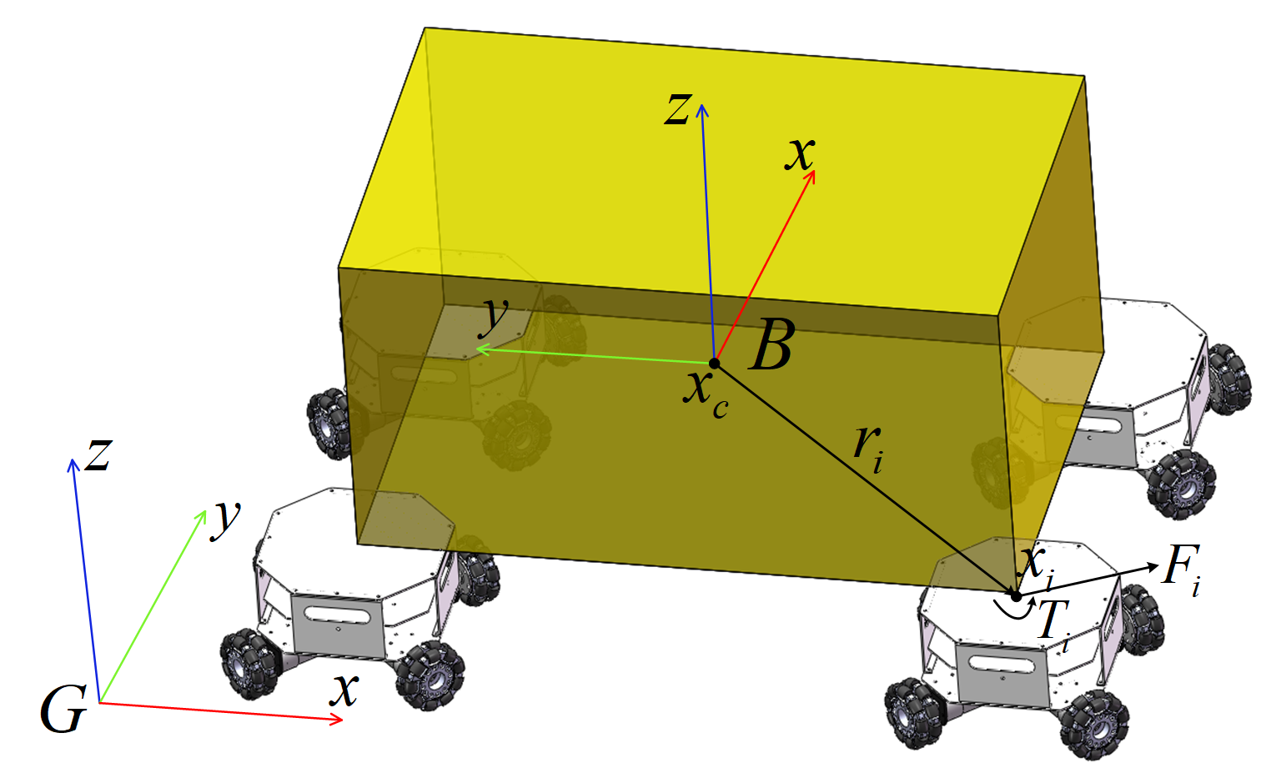
Distributed Adaptive Control of Multiple Robots for Cooperative Load Transportation
Bo Zhang, Pudong Liu, Runhao Xi, Youqiang Ye and Shiyu Chen
College of Mechatronics and Control Engineering, Shenzhen University, China
Yao Cui
Research & Development Institute of Northwestern Polytechnical University In Shenzhen, China
An adaptive control (MRAC) method based on model reference is proposed.
The common load state space model of multiple omnidirectional mobile robots is established.
The controller of automatic adjustment of control parameters is designed to approach the reference model.
Prior knowledge of robot position and load characteristics is not needed to control the robots transport load.
Multi-robot transport system

