Slide 1
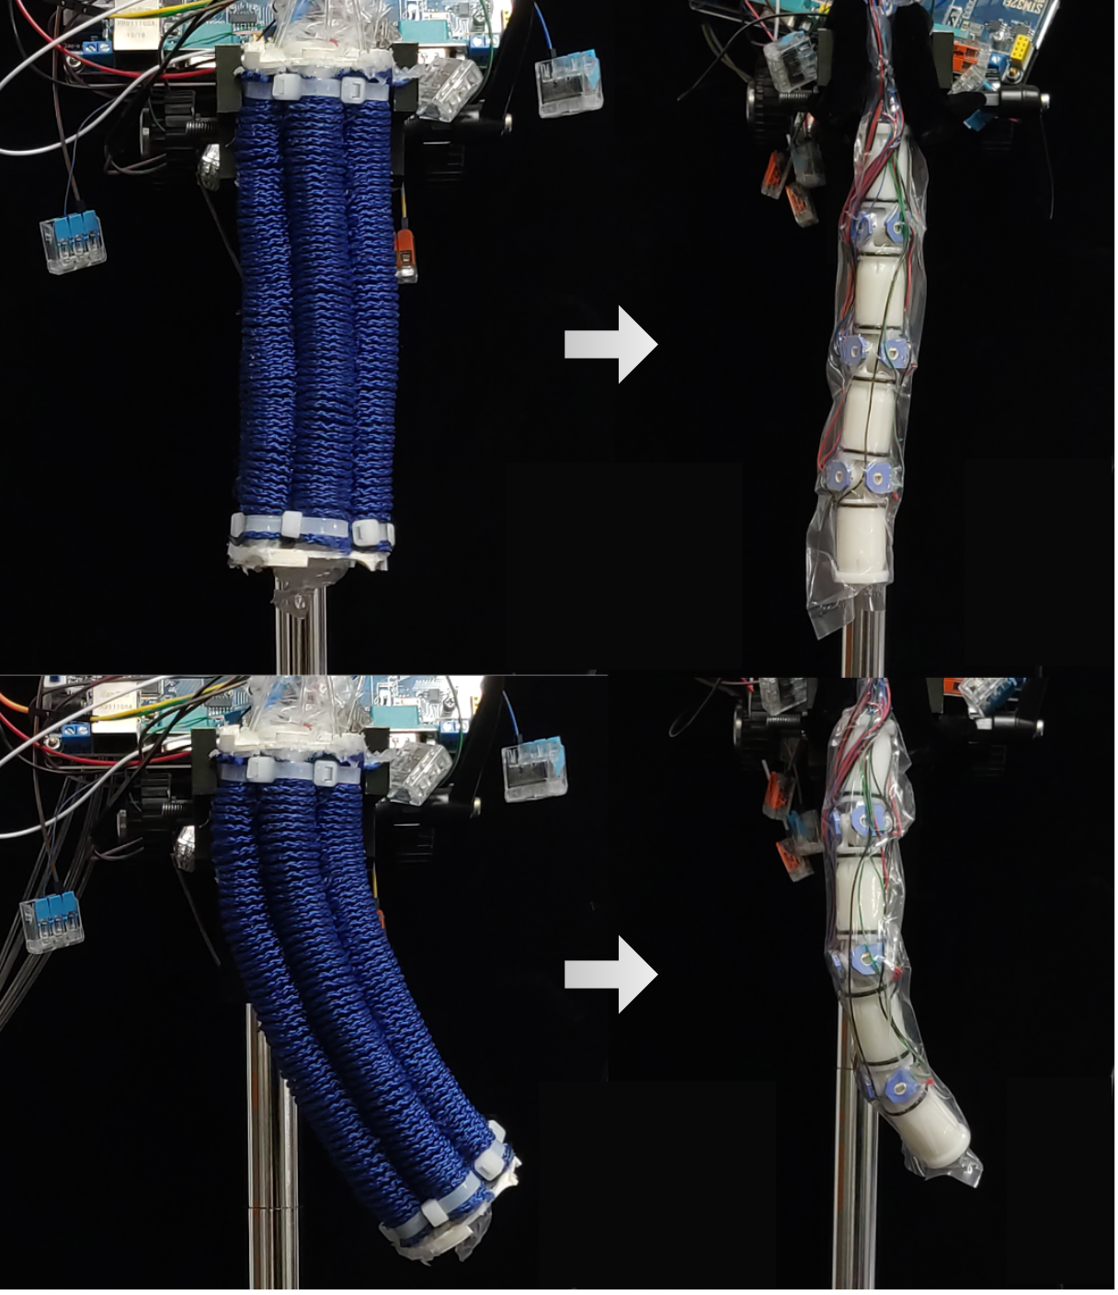
Design and implementation of variable stiffness rigid-soft coupling pneumatic actuated joint
Jinfeng Zhao, Changqu Wu, Wenbiao Wang, and Guanjun Bao
College of Mechanical Engineering,Zhejiang University of Technology, China
Rigid-flexible coupling joint with variable stiffness
Attitude sensing for soft-body robots
Stiffness test experiment of soft-body
A figure here
For figure caption (optional), use arial narrow 20pt font

